Slide 1





Slide 2







Slide 3
Round 1:

Slide 4

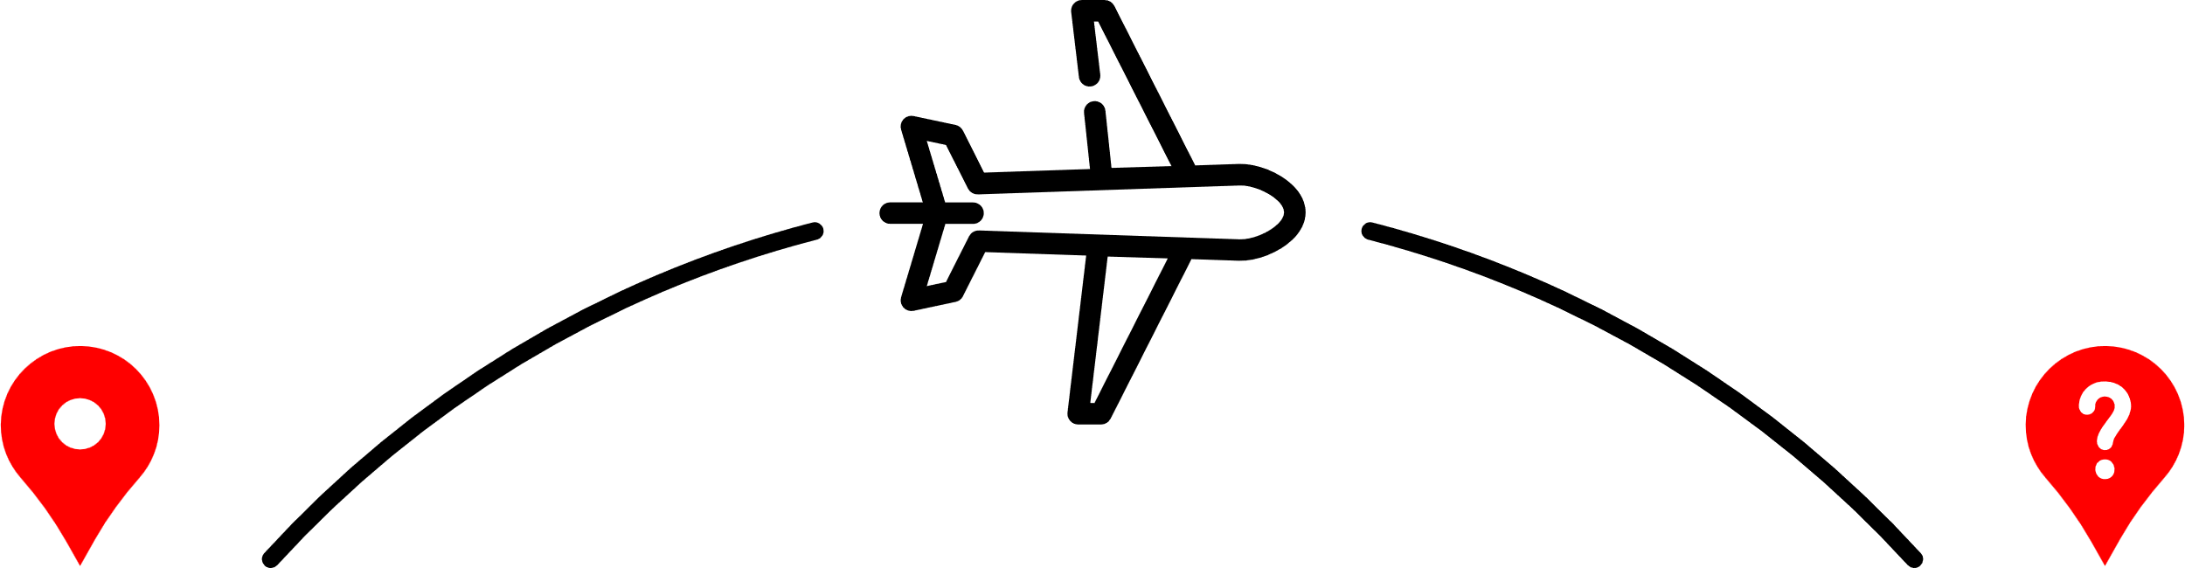

Question 1
If I fly…
SOUTH-WEST
1,577 miles
FROM
I AM IN
London
Iceland
Azores
Brazil
Canary Islands

Slide 5

Question 2
If I fly…
NORTH-EAST
1,131 miles
FROM
I AM IN
London
Helsinki
Prague
Moscow
Paris

Slide 6

Question 3
If I fly…
WEST
3,020 miles
FROM
I AM IN
Edinburgh
Mexico City
Las Vegas
Washington DC
Montreal

Slide 7

Question 4
If I drive…
SOUTH, SOUTH-EAST
371 miles
FROM
I AM IN
Edinburgh
Manchester
Cardiff
London
Leeds

Slide 8
Question 5
If I fly…
NORTH-EAST
1,162 miles
FROM
I AM IN
Madrid
Paris
Berlin
Vienna
Copenhagen

Slide 9
Question 6
If I fly…
SOUTH-WEST
5,766 miles
FROM
I AM IN
London
Casablanca
Rio de Janerio
Bogotá
Chihuahua

Slide 10
Question 7
If I drive…
SOUTH-WEST
1,078 miles
FROM
I AM IN
Paris
Rome
Zurich
Lisbon
Barcelona

Slide 11

Question 8
If I fly…
SOUTH, SOUTH-WEST
4,500 miles
FROM
I AM IN
Cairo
Cape Town
Lagos
Addis Ababa
Marrakech

Slide 12
Question 9
If I drive…
WEST
4,048 miles
FROM
I AM IN
Ethiopia
Nigeria
Tanzania
Ghana
Senegal

Slide 13
Question 10
If I fly…
NORTH-EAST
2,346 miles
FROM
I AM IN
New Delhi
Beijing
Kathmandu
Tokyo
Hong Kong

Slide 14
Round 1: Answers
Azores
Helsinki
Montreal
London
Berlin
Rio de Janeiro
Lisbon
Cape Town
Ghana
Beijing

Slide 15


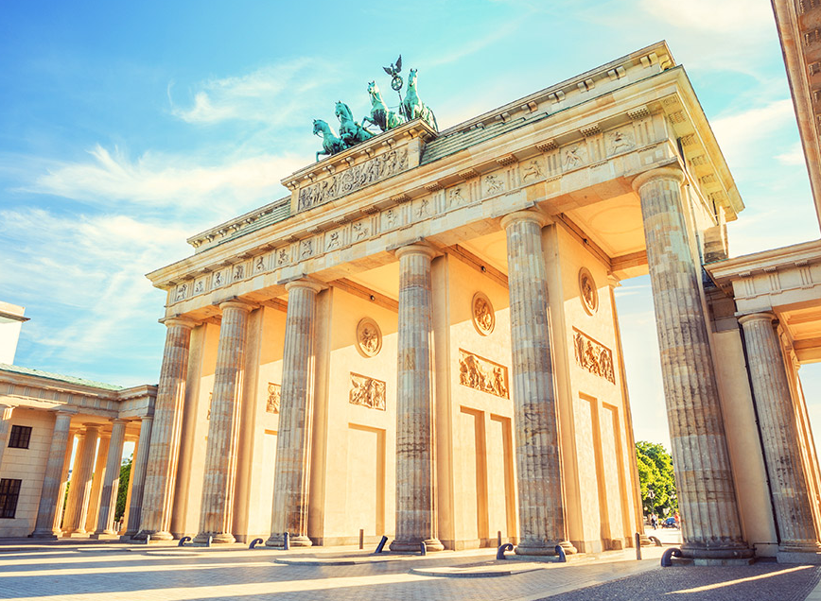


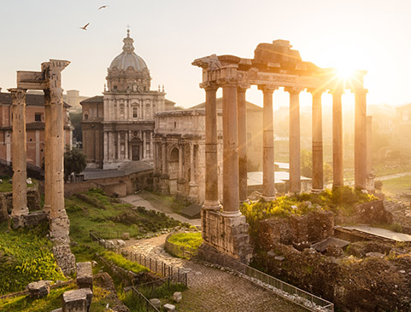
Round 2:

Slide 16
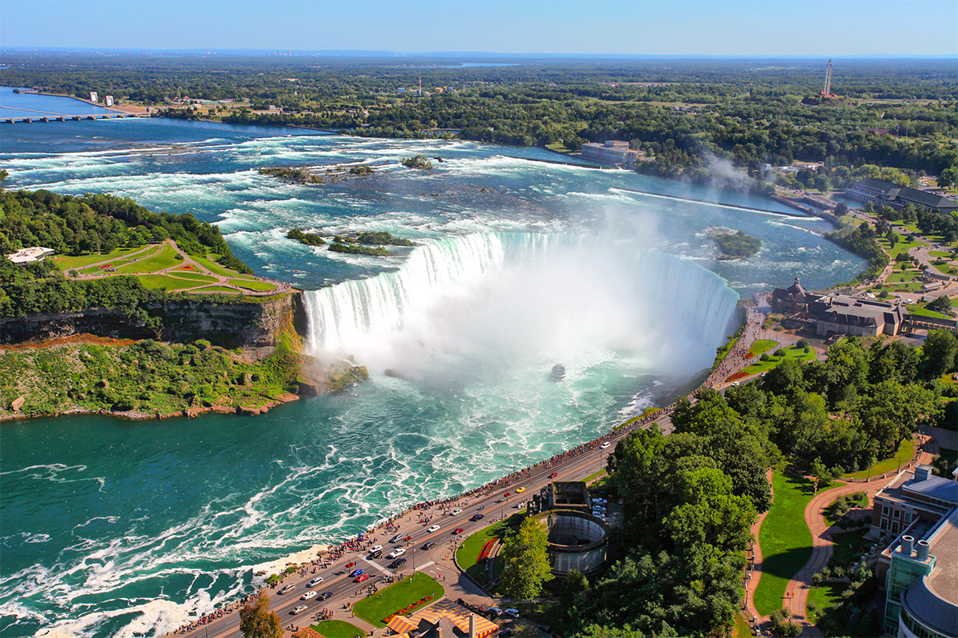



Question 1
3 marks: Correct with 1 Square Revealed
2 marks: Correct with 2 Squares Revealed
1 marks: Correct with 3 Squares Revealed

Slide 17
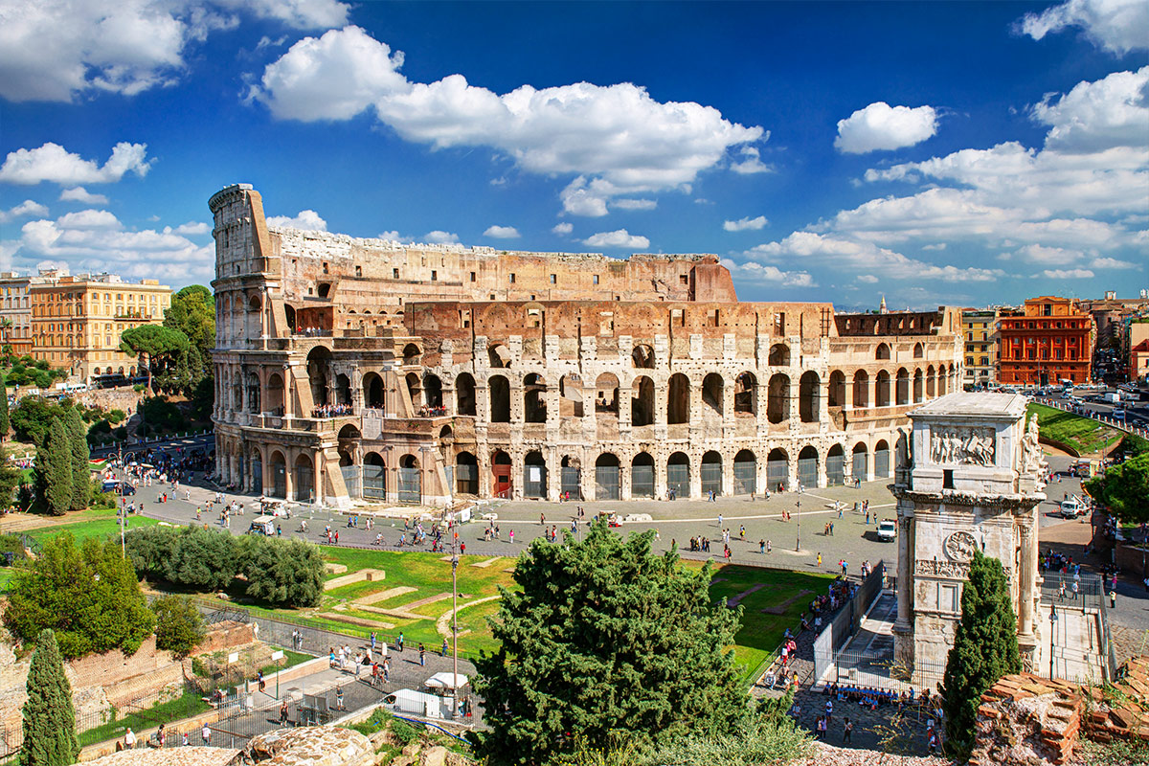
Question 2
3 marks: Correct with 1 Square Revealed
2 marks: Correct with 2 Squares Revealed
1 marks: Correct with 3 Squares Revealed

Slide 18
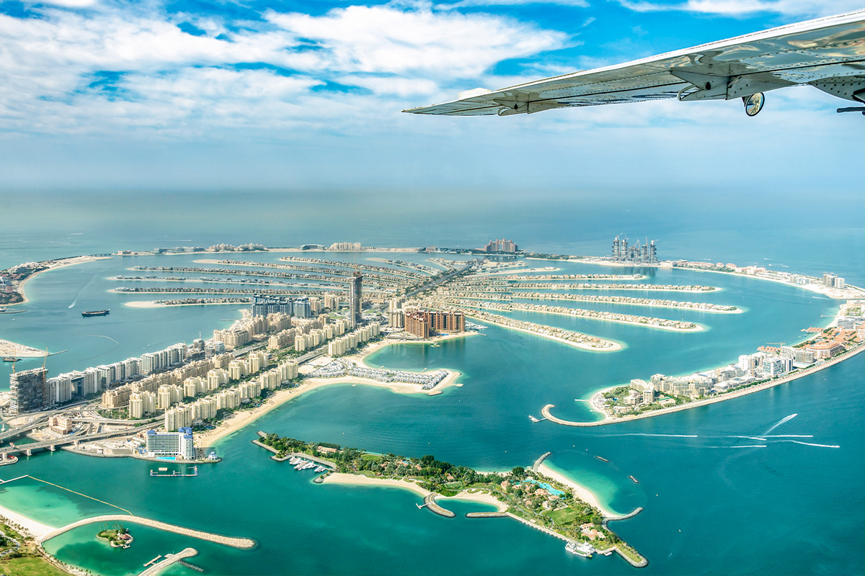
Question 3
3 marks: Correct with 1 Square Revealed
2 marks: Correct with 2 Squares Revealed
1 marks: Correct with 3 Squares Revealed

Slide 19
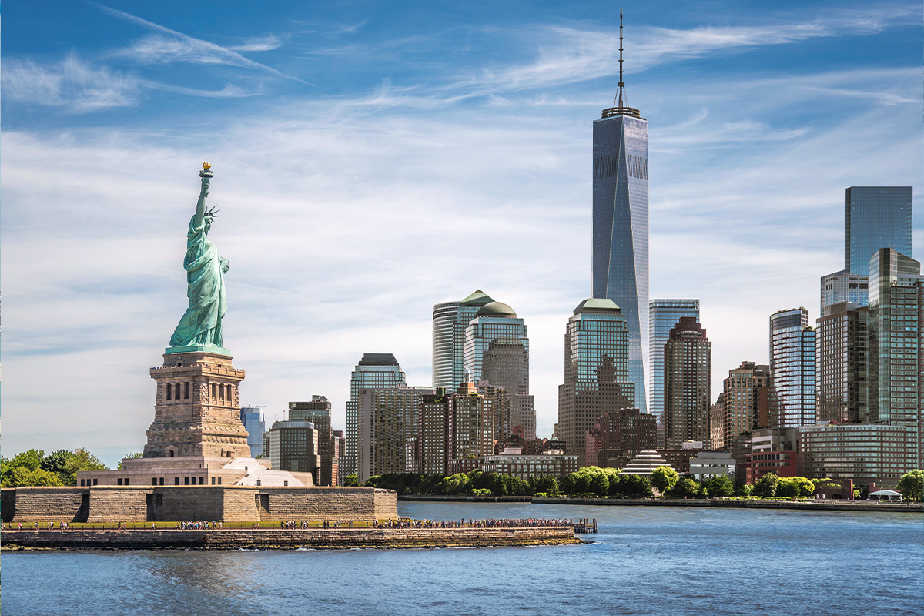
Question 4
3 marks: Correct with 1 Square Revealed
2 marks: Correct with 2 Squares Revealed
1 marks: Correct with 3 Squares Revealed

Slide 20
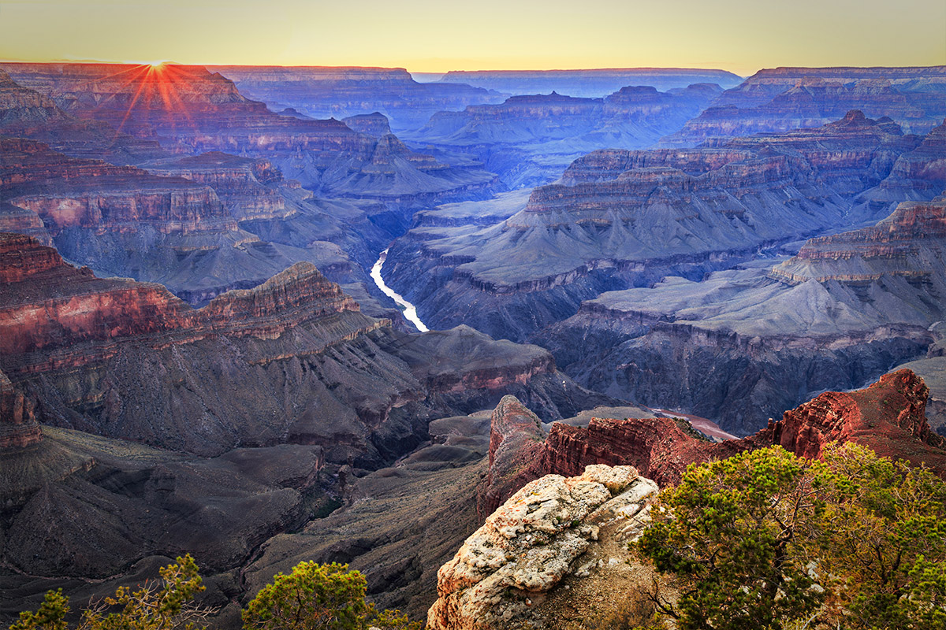
Question 5
3 marks: Correct with 1 Square Revealed
2 marks: Correct with 2 Squares Revealed
1 marks: Correct with 3 Squares Revealed

Slide 21
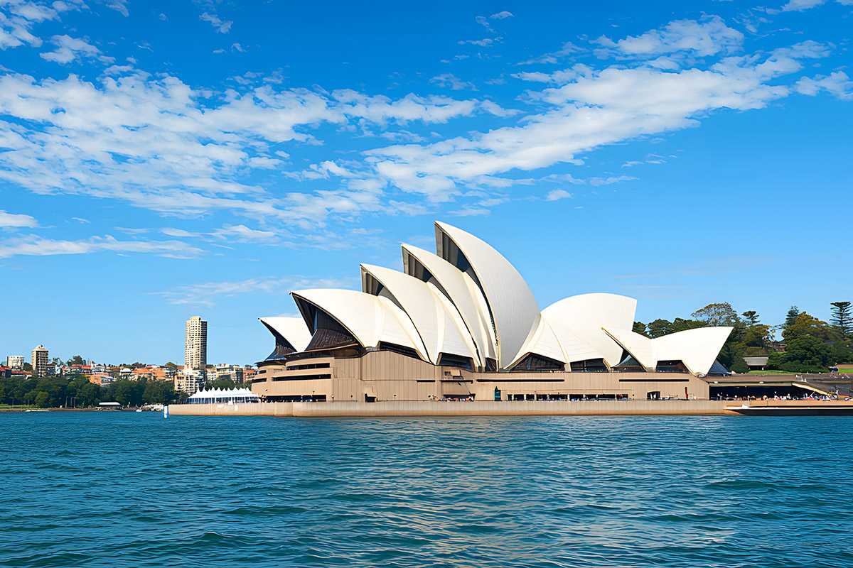
Question 6
3 marks: Correct with 1 Square Revealed
2 marks: Correct with 2 Squares Revealed
1 marks: Correct with 3 Squares Revealed

Slide 22
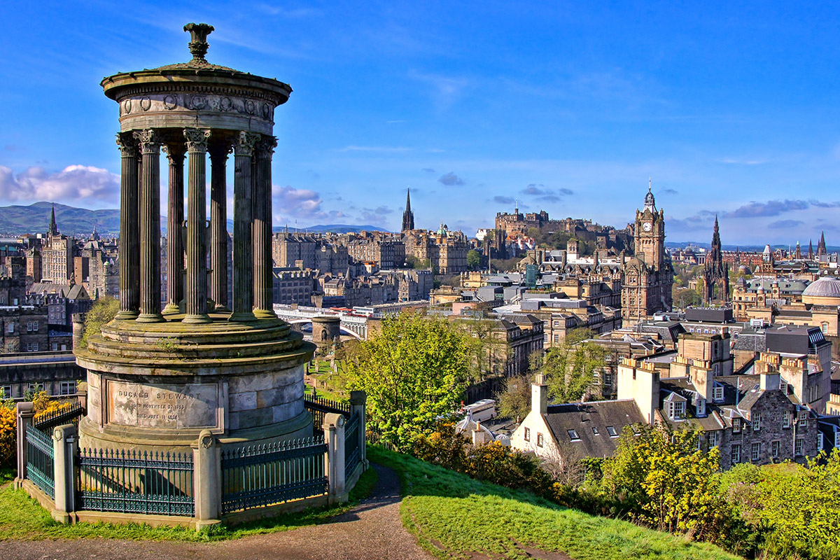
Question 7
3 marks: Correct with 1 Square Revealed
2 marks: Correct with 2 Squares Revealed
1 marks: Correct with 3 Squares Revealed

Slide 23
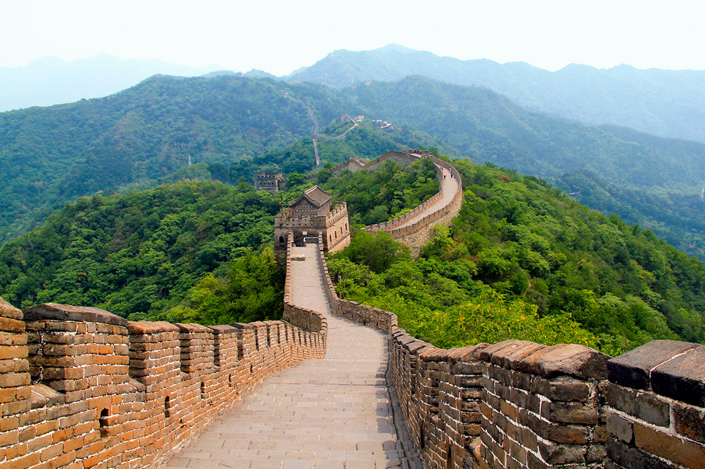
Question 8
3 marks: Correct with 1 Square Revealed
2 marks: Correct with 2 Squares Revealed
1 marks: Correct with 3 Squares Revealed

Slide 24
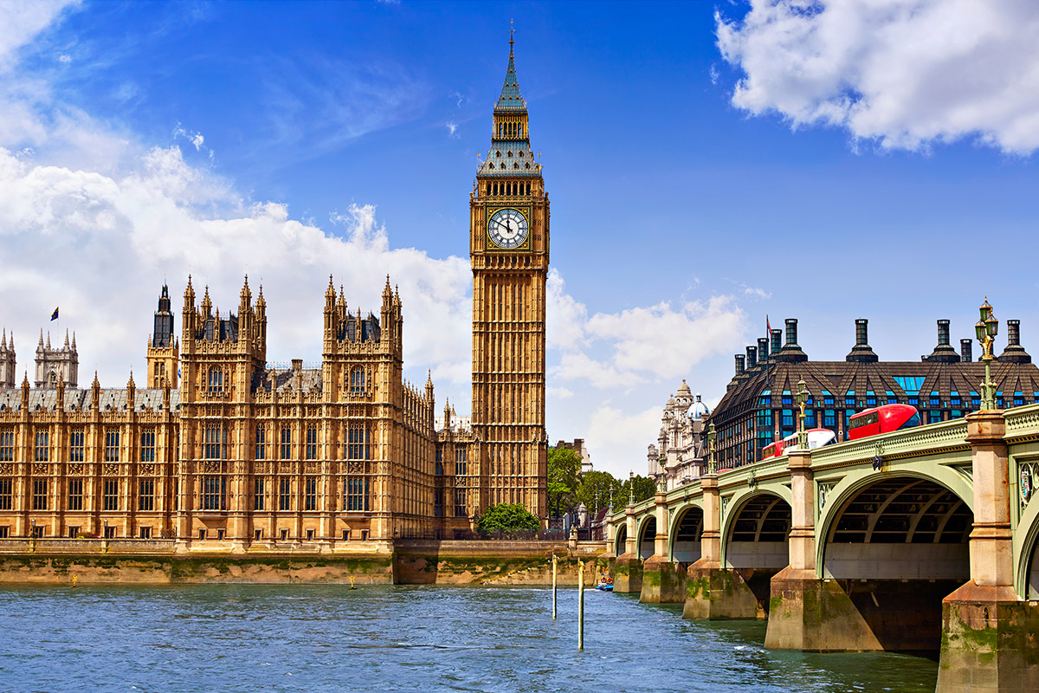
Question 9
3 marks: Correct with 1 Square Revealed
2 marks: Correct with 2 Squares Revealed
1 marks: Correct with 3 Squares Revealed

Slide 25
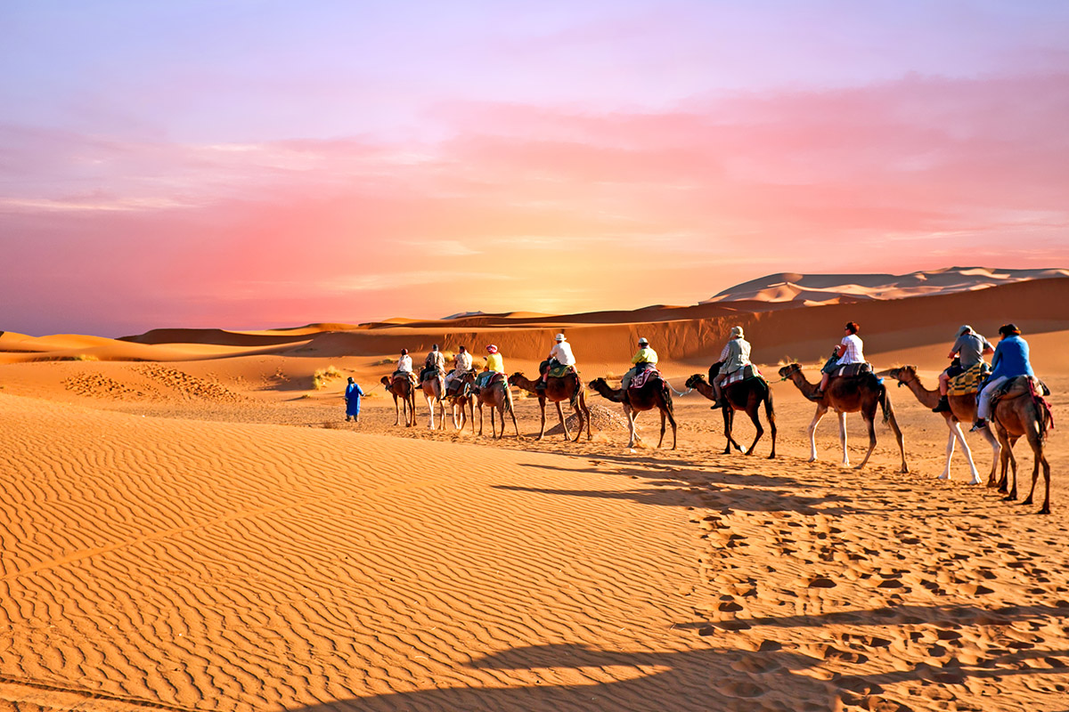
Question 10
3 marks: Correct with 1 Square Revealed
2 marks: Correct with 2 Squares Revealed
1 marks: Correct with 3 Squares Revealed

Slide 26
Round 2: Answers
Niagara Falls
The Colosseum, Rome
Palm Island, Dubai
New York City
The Grand Canyon
Sydney Opera House
Edinburgh
Great Wall of China
London
The Sahara

Slide 27


Round 3:
But… What IS
THE QUESTION?

Slide 28

Question 1
The Equator

Slide 29
Question 2
This layer is extremely hot with semi-liquid molten rock churning around.

Slide 30
Question 3
The wearing away of material like rock by wind, water, ice or gravity.

Slide 31
Question 4
Energy that can be recreated and will not run out.

Slide 32
Question 5
Looking after resources and the environment in a way that will benefit the present and the future.

Slide 33
Question 6
Deciduous trees like oaks.

Slide 34
Question 7
The point on the ground above the focus where an earthquake has started.

Slide 35
Question 8
Mount Kilimanjaro

Slide 36
Question 9
The spreading out or sprawling of towns and cities into rural areas.

Slide 37
Question 10
The movement of people to live or work.

Slide 38
Round 3: Answers
What is the name given to the imaginary line running around the middle of the Earth?
What is Earth’s mantle layer like?
What is meant by erosion?
What is a renewable form of energy?
What does sustainability mean?
What type of tree loses it leaves in winter?
What is the epicentre?
What is the highest mountain in Africa?
What is urbanisation?
What is migration?

Slide 39
Round 4:
HIGHER
OR
LOWER

Slide 40

Question 1
The population of Mongolia is…
HIGHER
LOWER
than Iceland’s?
www.rayburntours.com

Slide 41
Question 2
The tallest mountain in Europe is
HIGHER
LOWER
than the tallest mountain in Antarctica?
www.rayburntours.com

Slide 42
Question 3
The latitude of London is
HIGHER
LOWER
than the latitude of New York city?
www.rayburntours.com

Slide 43
Question 4
The temperature of the Kalahari desert is
HIGHER
LOWER
than in Death Valley?
www.rayburntours.com

Slide 44
Question 5
The average rainfall in Sweden is
HIGHER
LOWER
than the average in Wales?
www.rayburntours.com

Slide 45
Question 6
The cost of a can of Coke in London is
HIGHER
LOWER
than in Beijing?
www.rayburntours.com

Slide 46
Question 7
The life expectancy in the USA is
HIGHER
LOWER
than the life expectancy in France?
www.rayburntours.com

Slide 47
Question 8
The $GDP per capita in Norway is
HIGHER
LOWER
than the $GDP per capita in Germany?
www.rayburntours.com

Slide 48
Question 9
The total length of the longest river in North America is
HIGHER
LOWER
than the longest river in South America
www.rayburntours.com

Slide 49
Question 10
The average price of a house in England is
HIGHER
LOWER
than the average price of a house in Austria?
www.rayburntours.com

Slide 50
Round 4: Answers
Mongolia’s population is 8x higher than Iceland’s
Europe’s Mount Elbrus is 750m higher than Mount Vinson in Antarctica
London’s latitude is 51.5°N higher than New York at 40.7 °N
The Kalahari’s desert highest temperature 42.5°C is lower than in Death Valley 56.7 °C
The average rainfall in Sweden is lower than in Wales
The cost of a can of coke in England is £1 higher than in Beijing
The life expectancy in the USA is 4 years lower than in France
The $GDP per capita in Norway is 35% higher than in Germany
The length of the longest river (Mississippi-Missouri) in North America is 443miles lower than the length of the River Amazon in South America
The average price of a house in England is $80’000 lower than in Austria

Slide 51
Round 5:

Slide 52
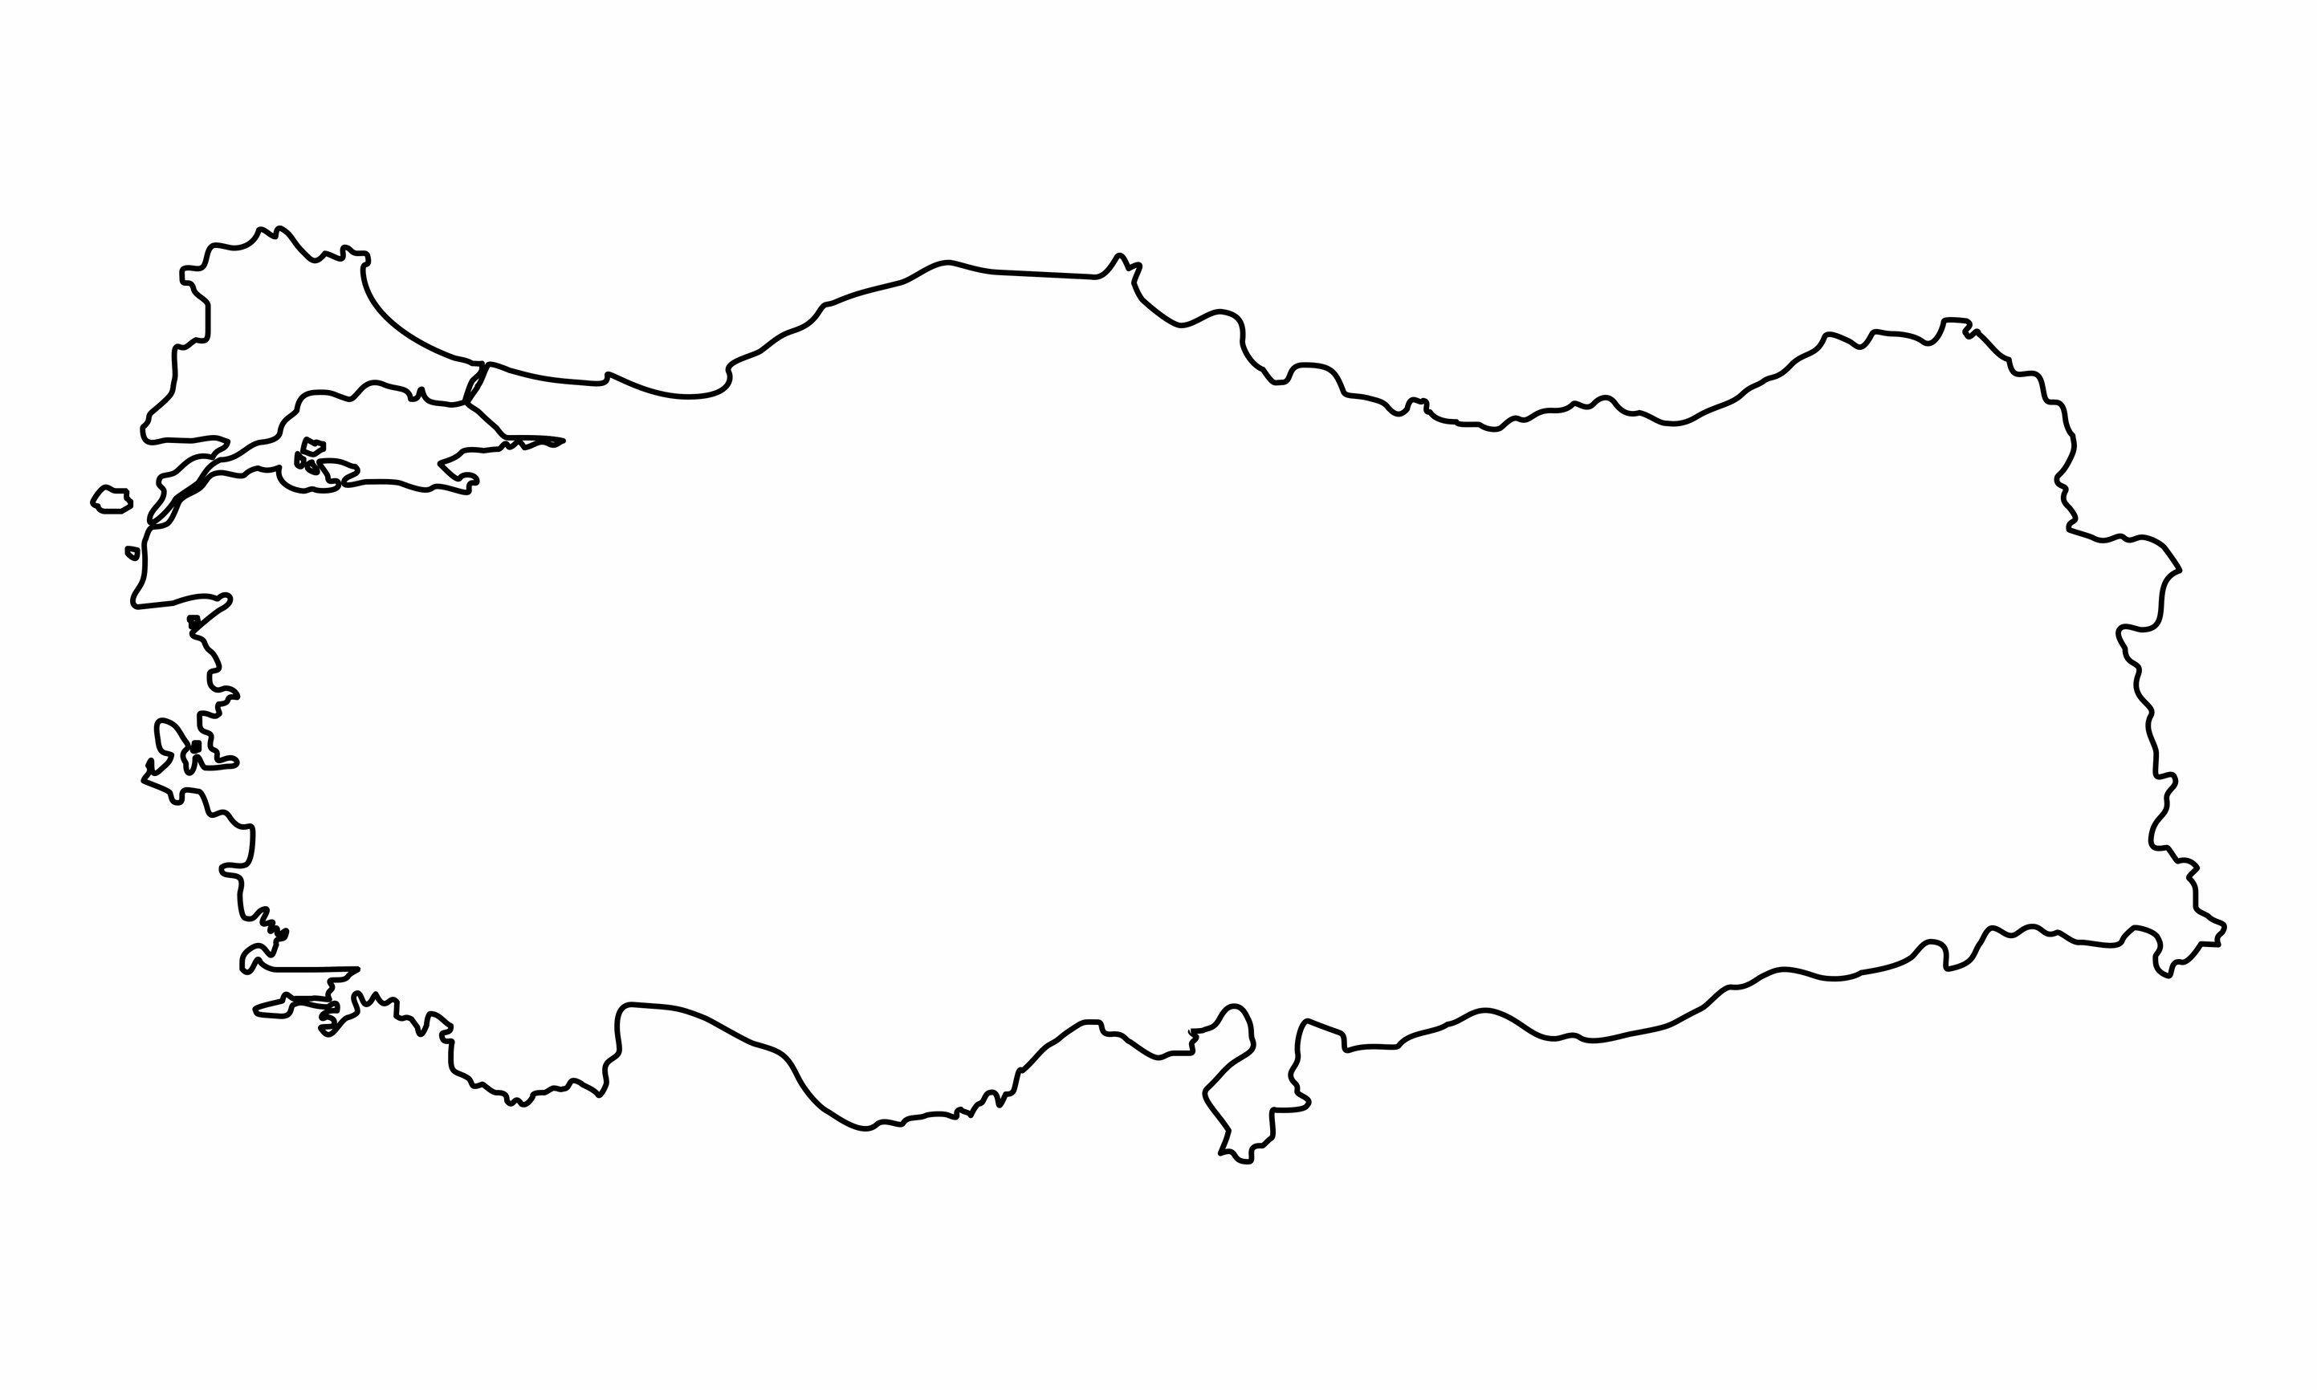
What country am I?
Question 1
I boast the oldest man-made structure in the world
I span across two continents, Europe and Asia
My local cuisine is famous for kebabs, baklava and mezes

Slide 53
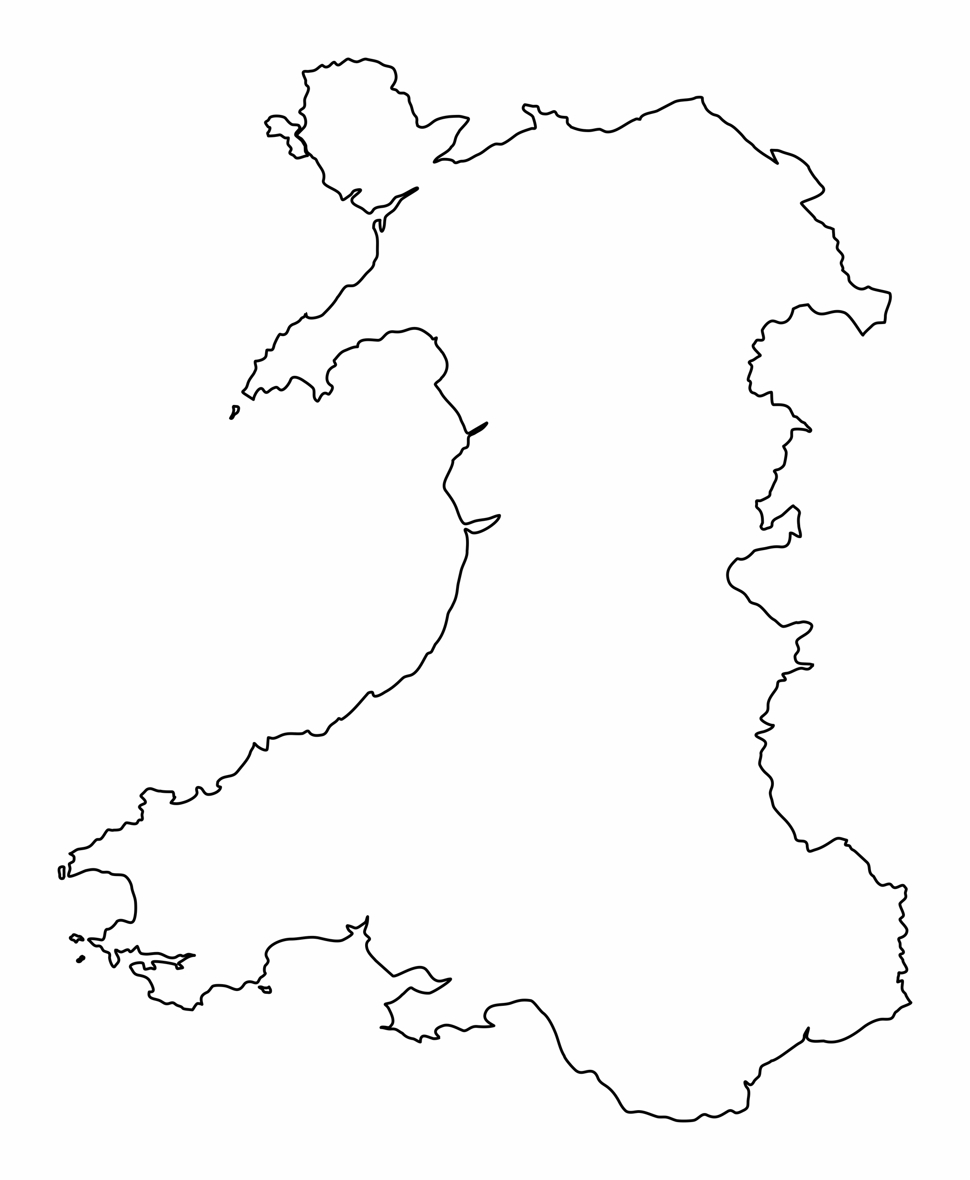
What city am I?
Question 2
I am the youngest capital city in Europe
Roald Dahl is one of many famous people born here
The Principality Stadium is one of the largest stadiums in Europe

Slide 54
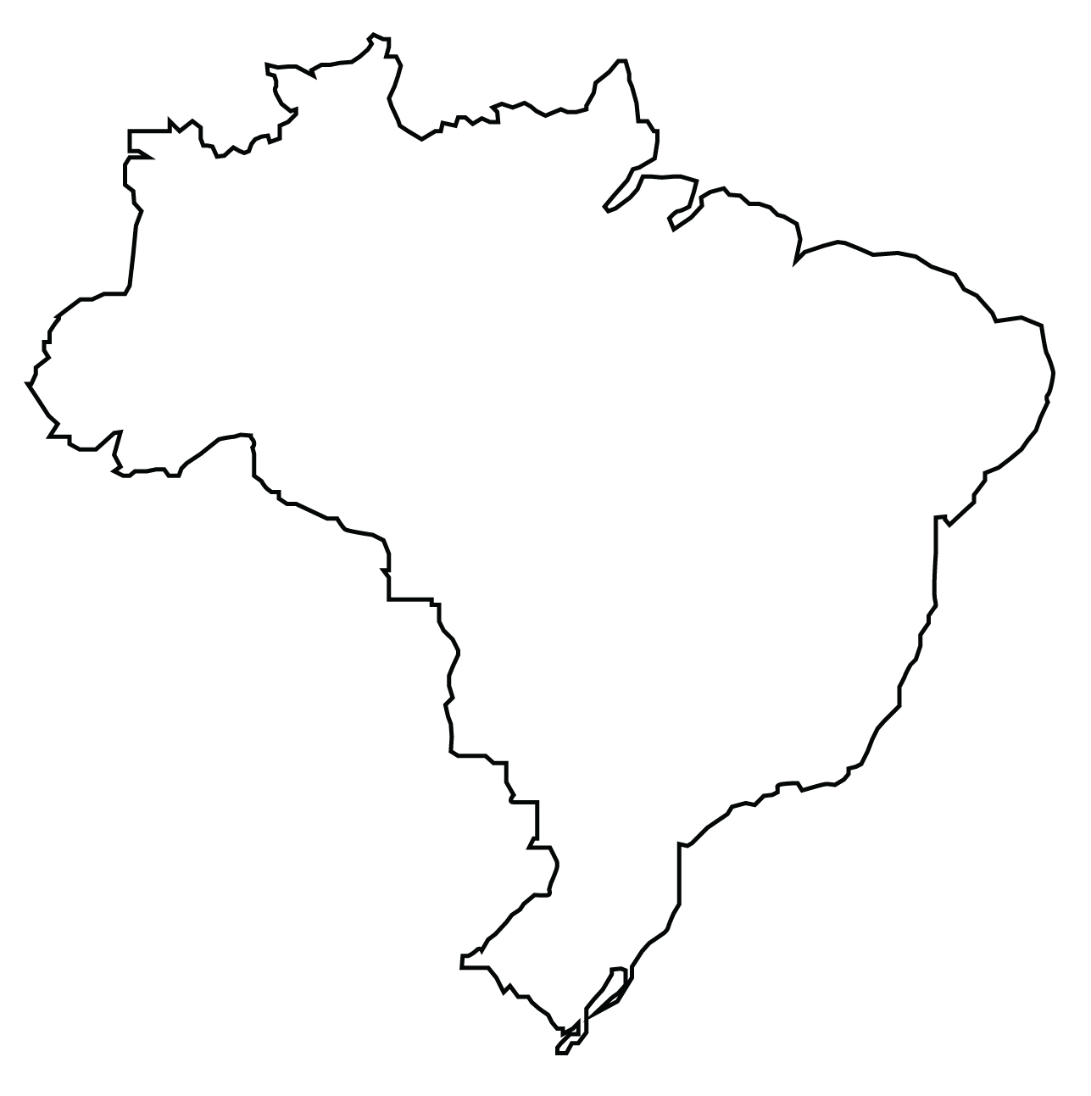
What landmark am I?
Question 3
I am considered one of the New Seven Wonders of the World
I stand on top of Mount Corcovado above Rio de Janeiro
My arms stretch 28m wide

Slide 55
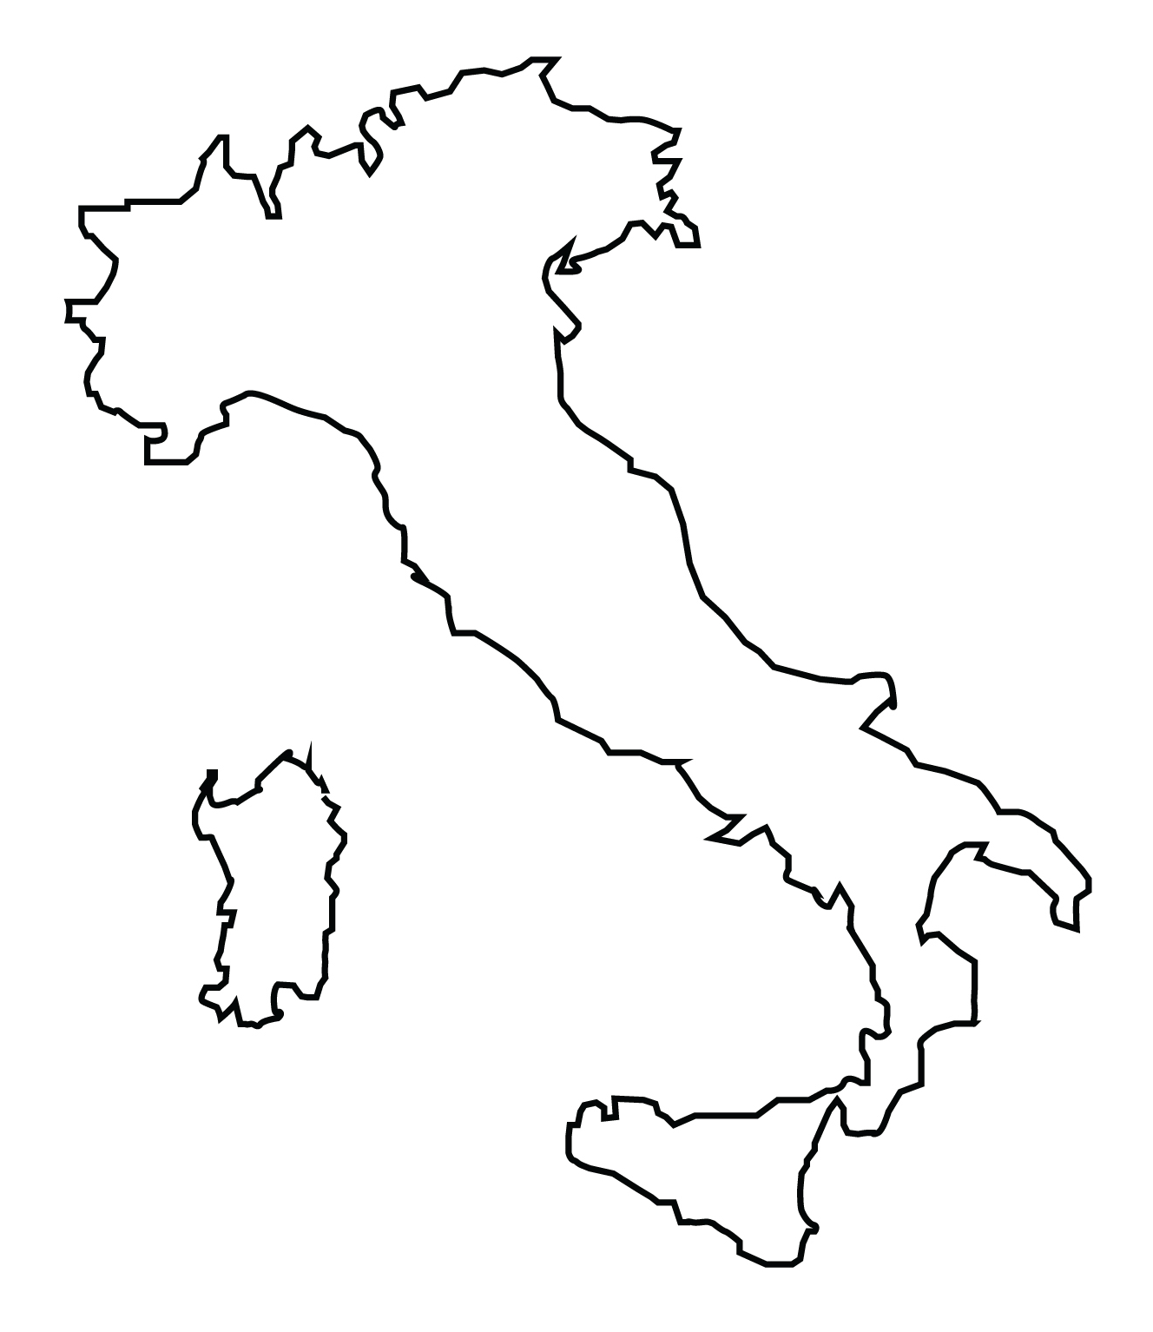
What country am I?
Question 4
I am home to the most UNESCO World Heritage Sites
I am famous for looking like footwear!
I have a very wonky building

Slide 56
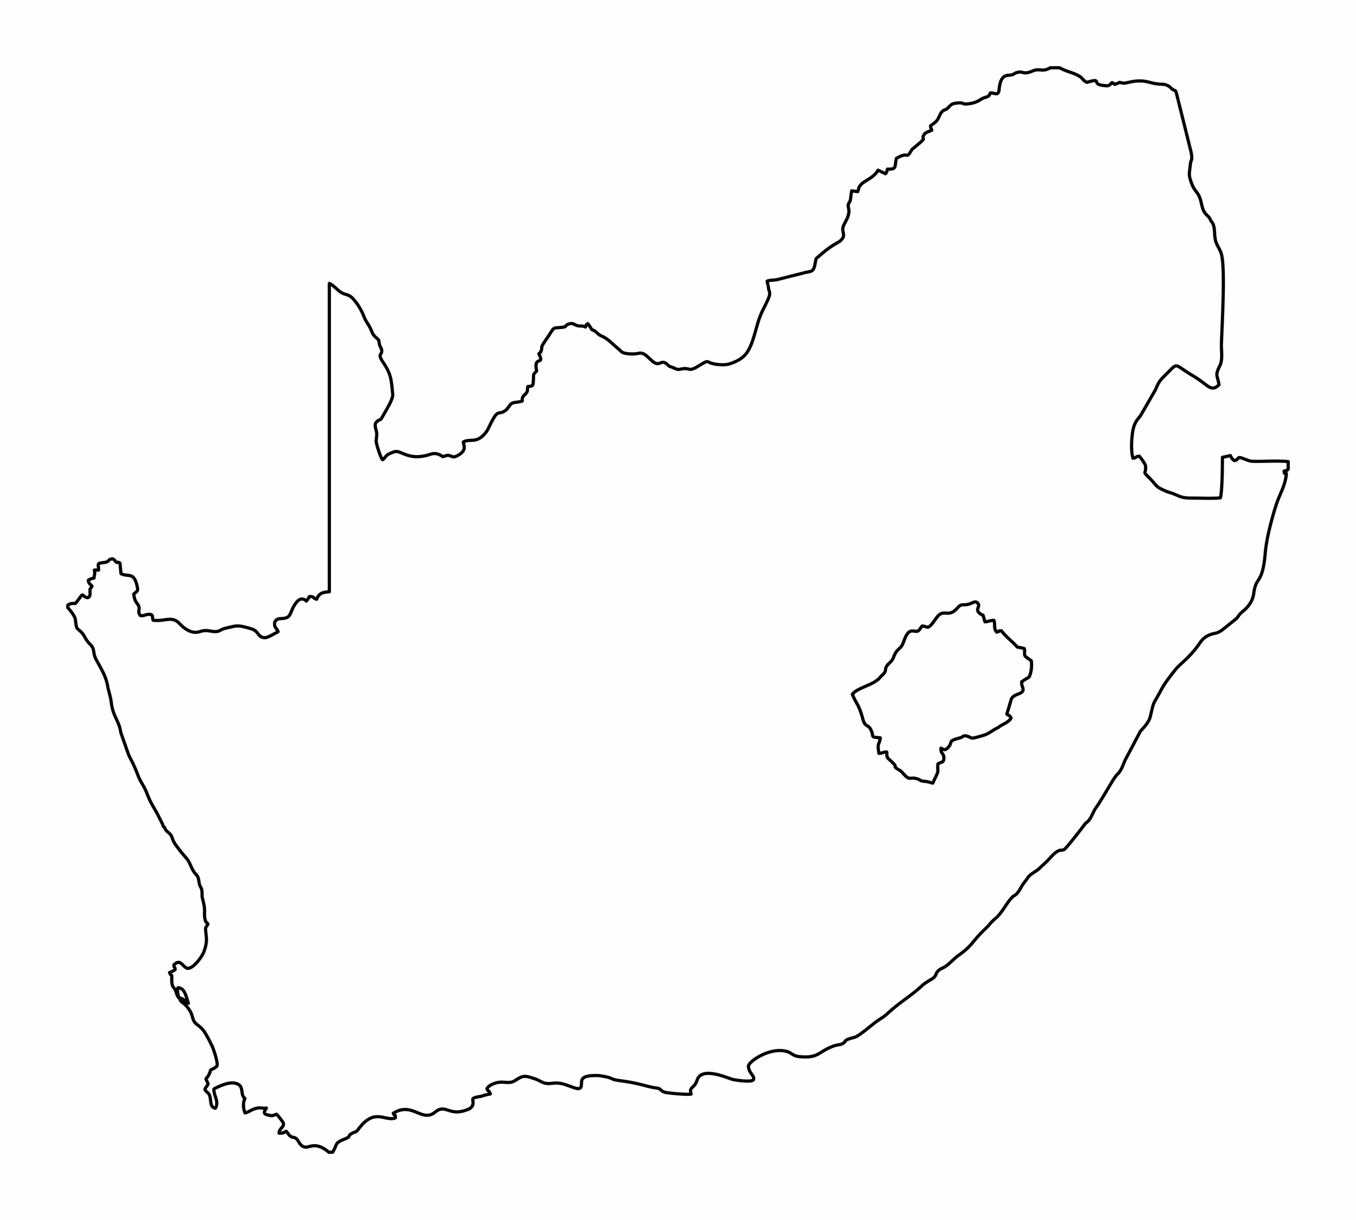
What city am I?
Question 5
I have a famous table-shaped mountain
I am located at the meeting point of two oceans, Atlantic & Indian
I have many languages, including Xhosa and Afrikaans

Slide 57
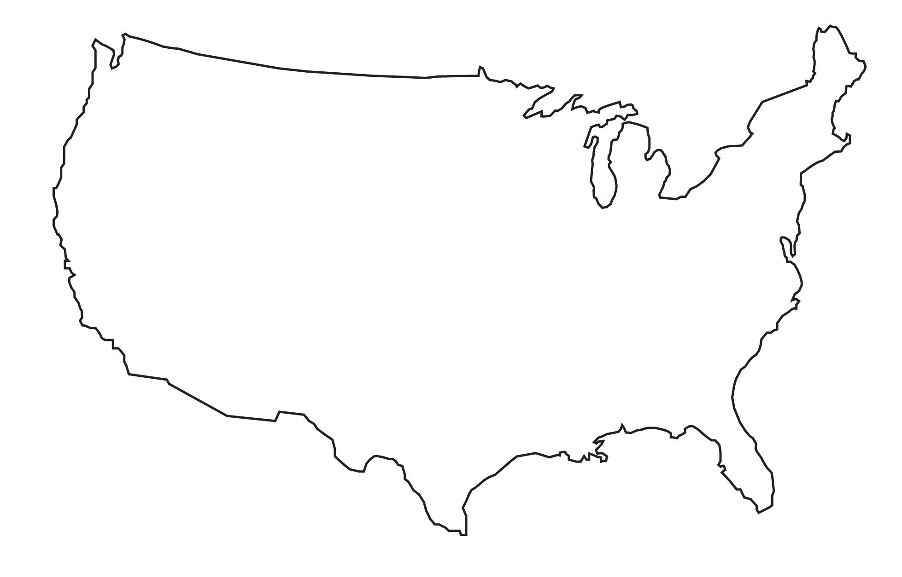
What landmark am I?
Question 6
I was a gift from France to celebrate friendship
I am a symbol of freedom and democracy
I hold a torch

Slide 58
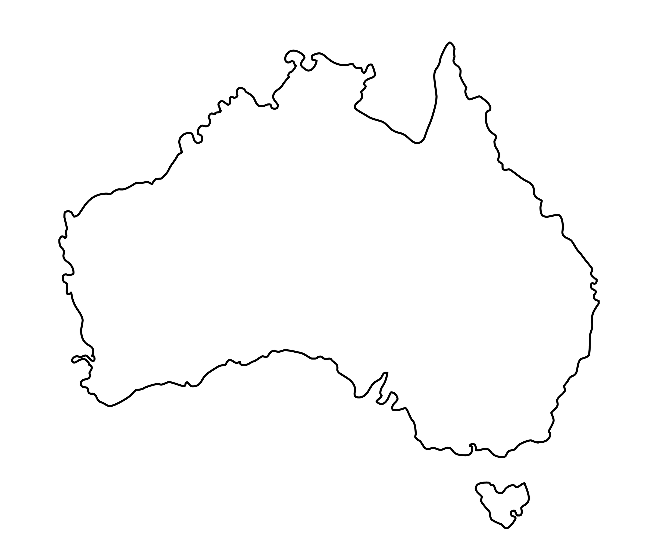
What country am I?
Question 7
I am a country and also a continent
I have the largest coral reef in the world
I am 70% desert or semi-desert

Slide 59
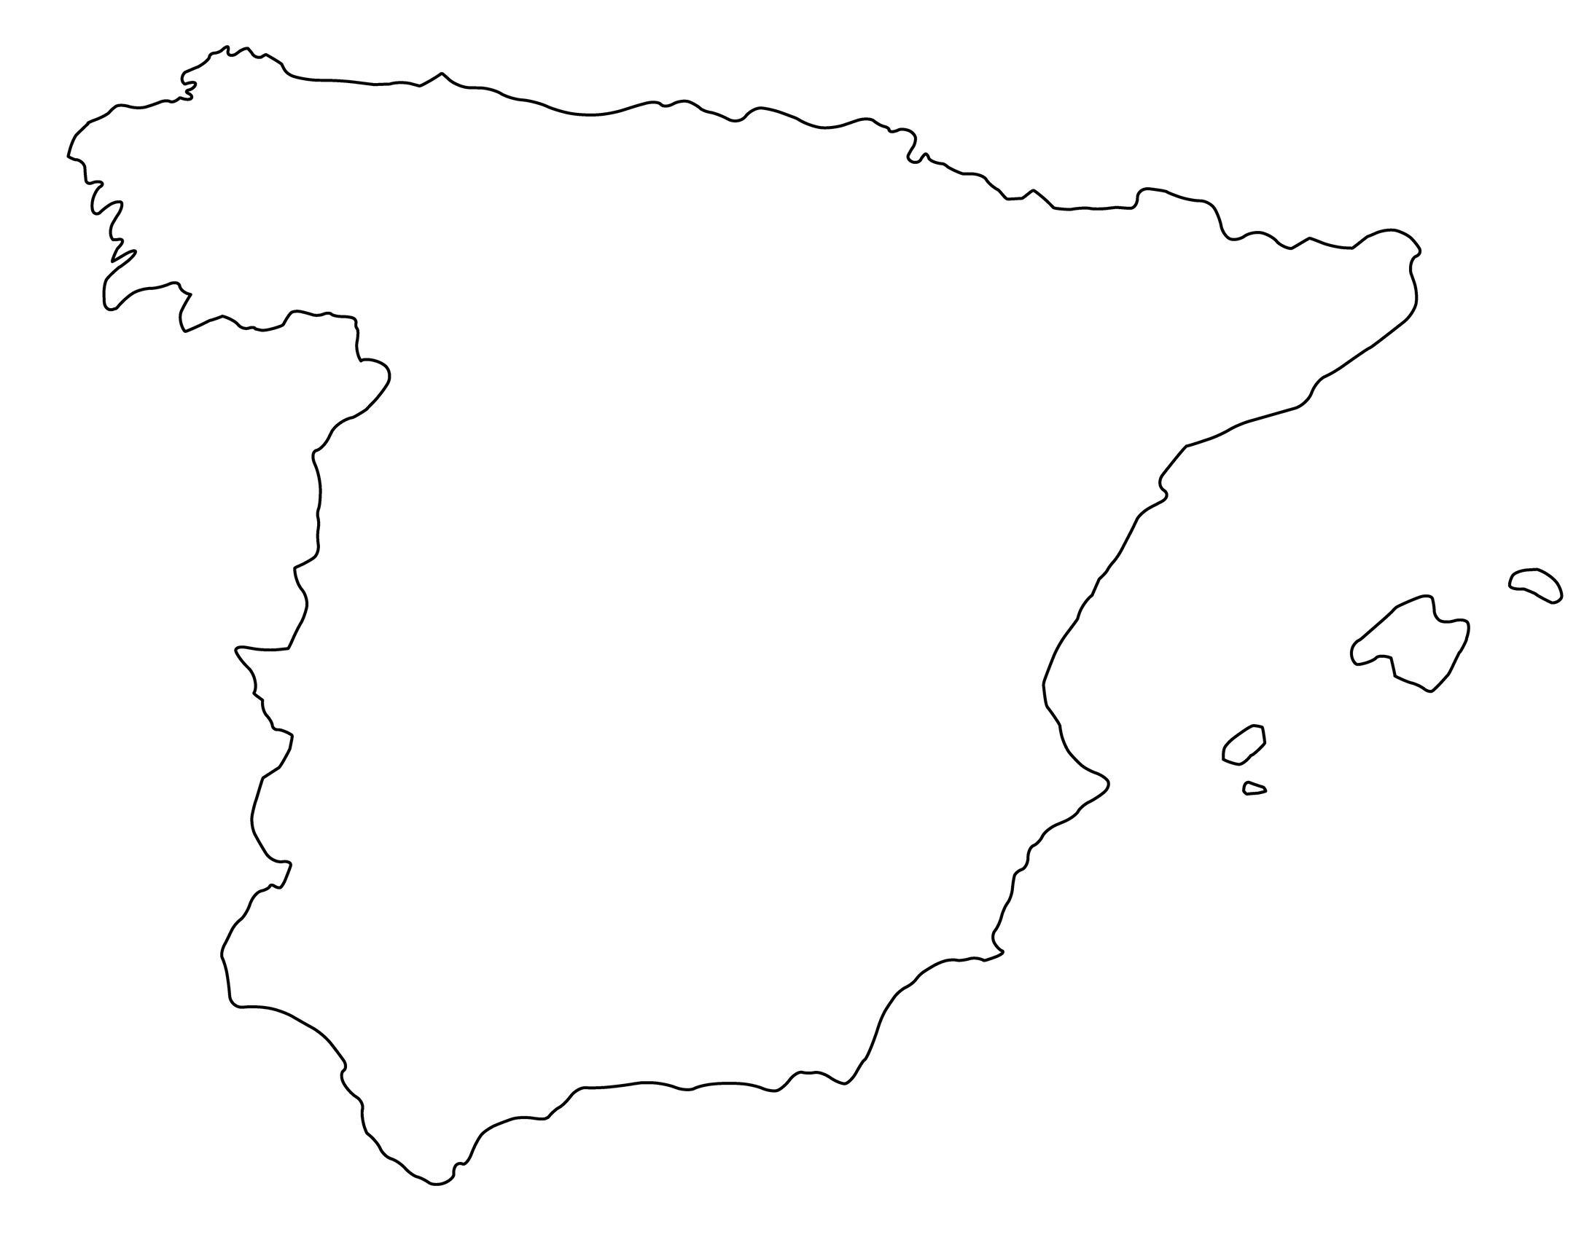
What city am I?
Question 8
I am the birthplace of tapas
The Santiago Bernabéu stadium is found here
I am one of Europe’s sunniest capital cities

Slide 60
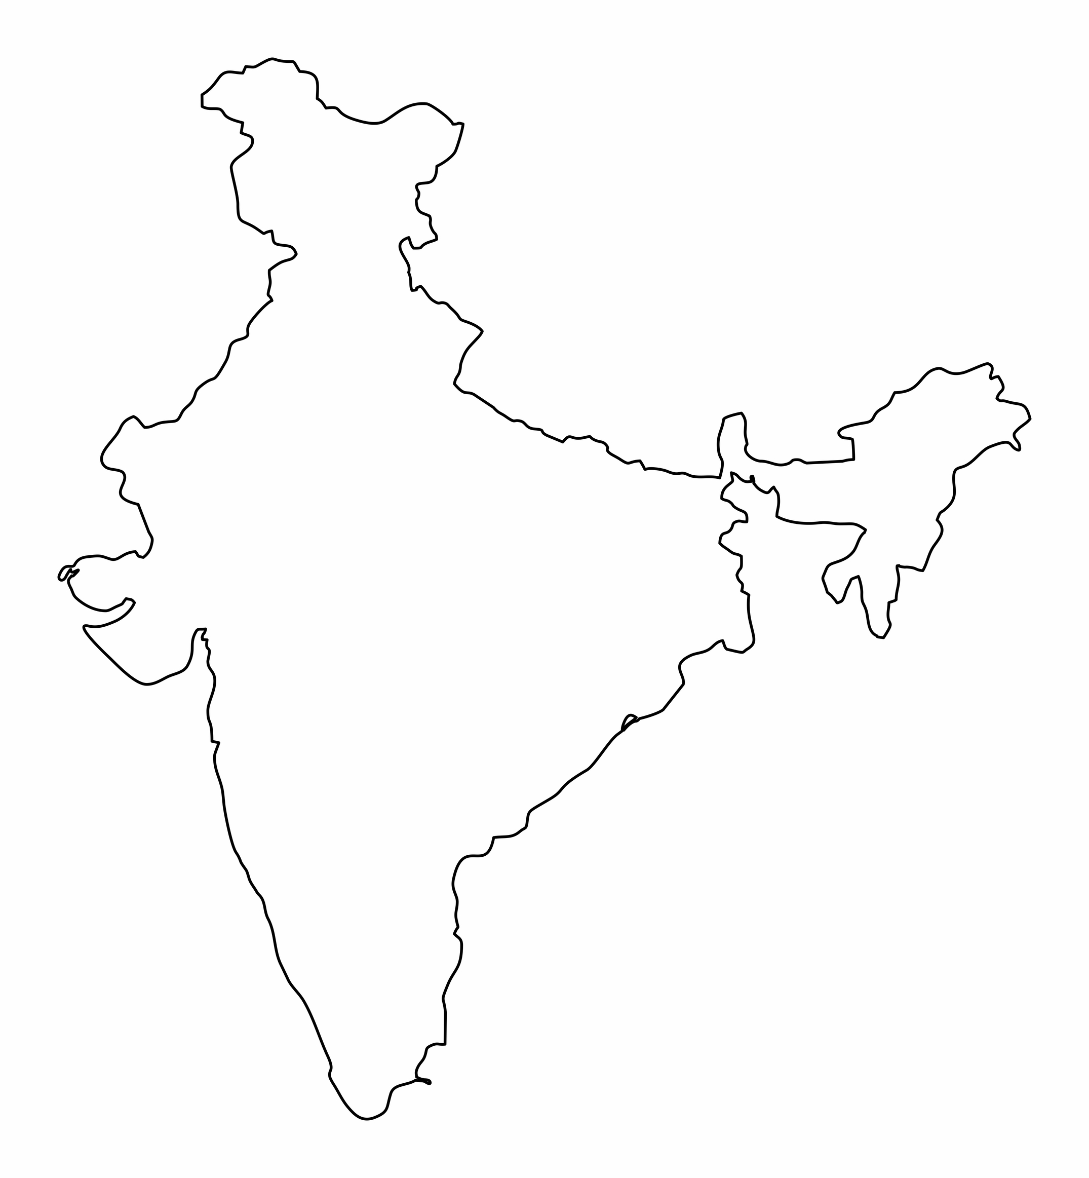
What landmark am I?
Question 9
I am a symbol of eternal love made in 1631
I have two tombs inside
I am 140 miles away from New Delhi

Slide 61
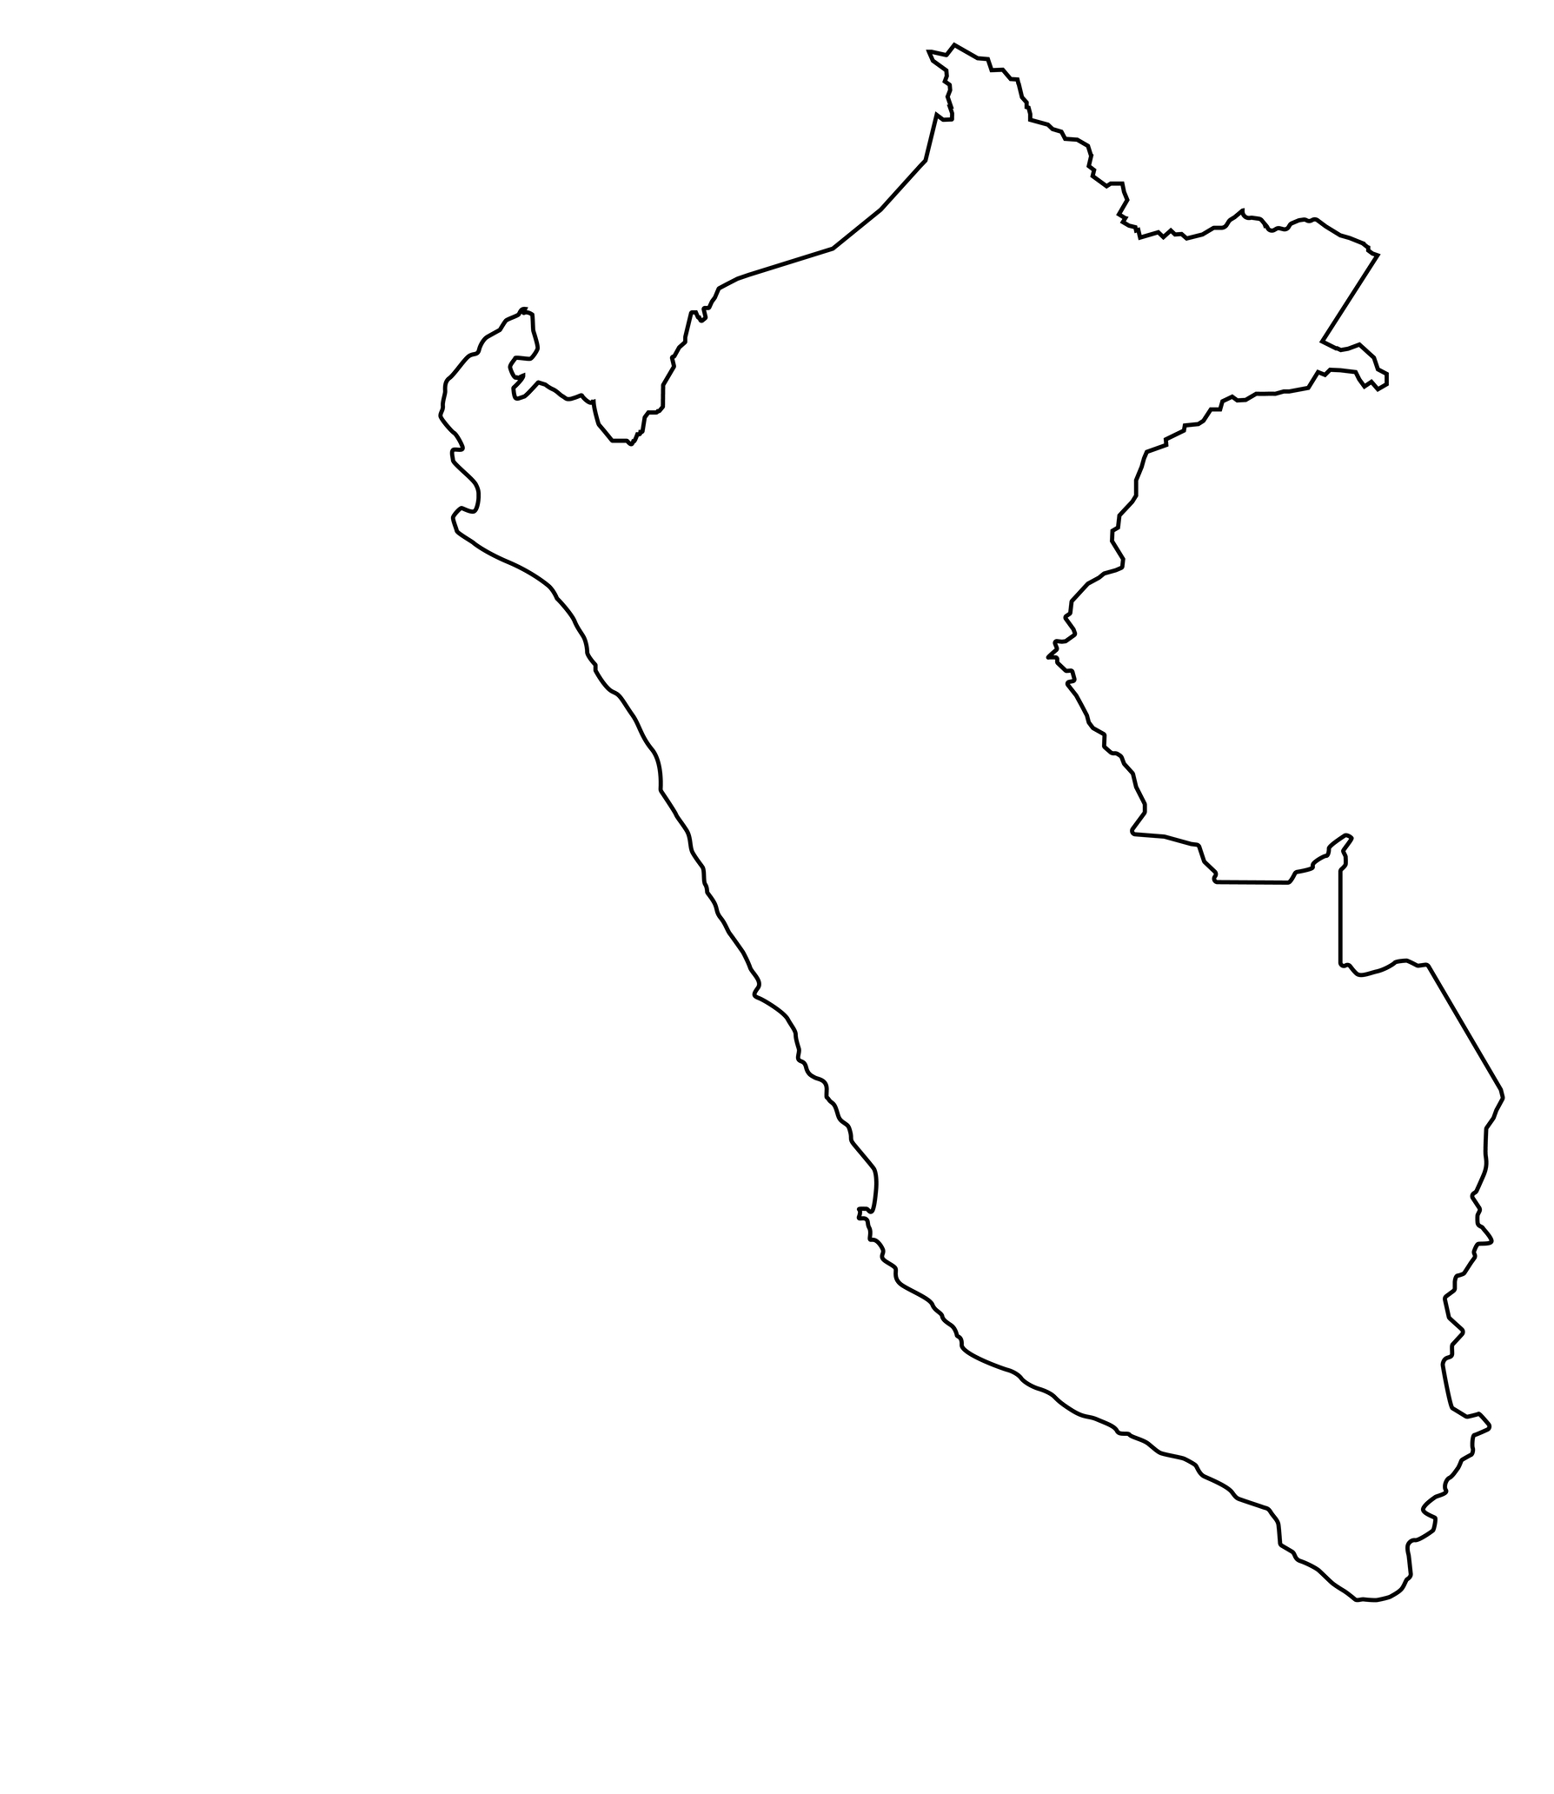
What country am I?
Question 10
I am the home of Machu Picchu
I host the source of the River Amazon
I contain mountains, rainforest, desert and beaches

Slide 62
Round 5: Answers
Turkey
Cardiff
Statue of Christ the Redeemer
Italy
Cape Town
Statue of Liberty
Australia
Madrid
Taj Mahal
Peru

Slide 63

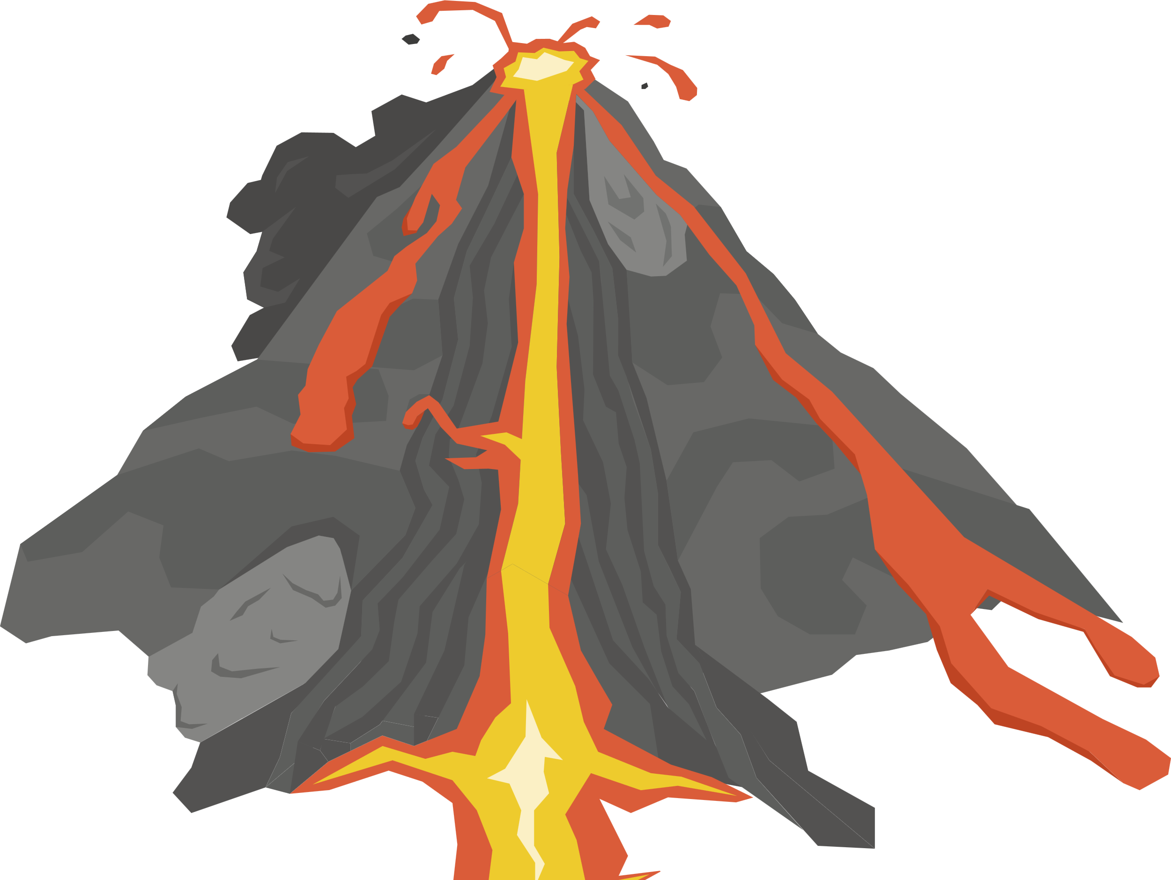
Round 6:

Slide 64
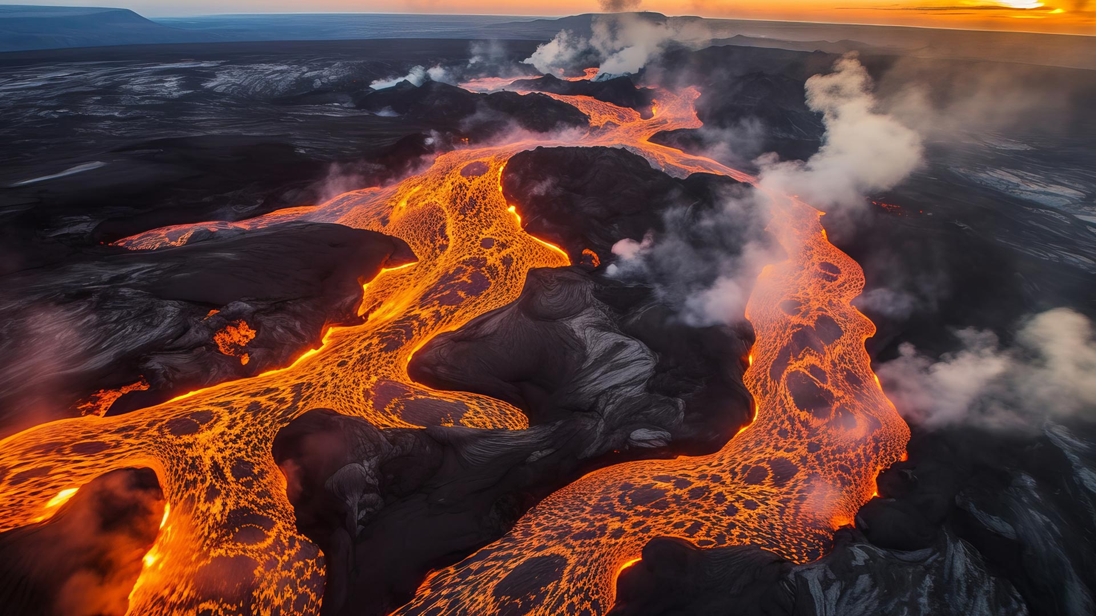
Iceland is currently experiencing it’s tenth volcanic eruption since 2021.
Question 1
TRUE
FALSE
www.rayburntours.com

Slide 65
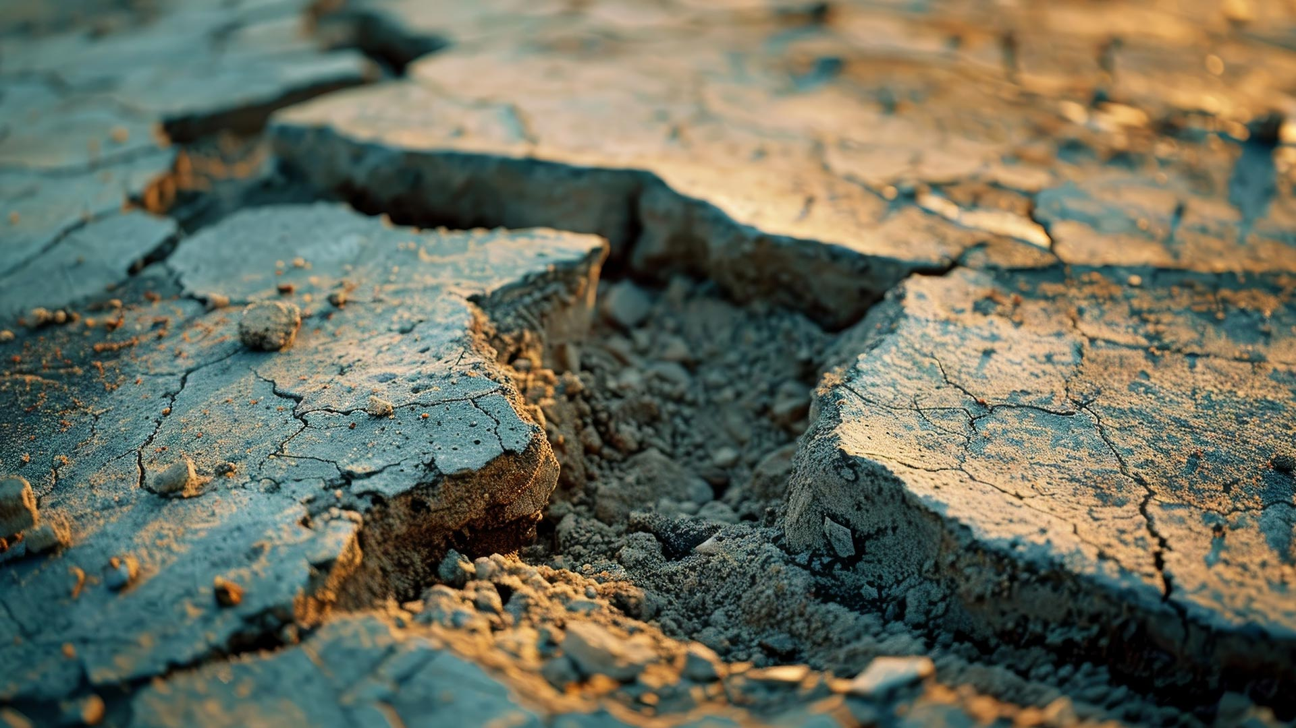
What is the main cause of earthquakes?
Question 2
A
B
C
D
Volcanic Eruptions
Movement of tectonic plates
Monsoon rains
Tidal Waves
www.rayburntours.com

Slide 66
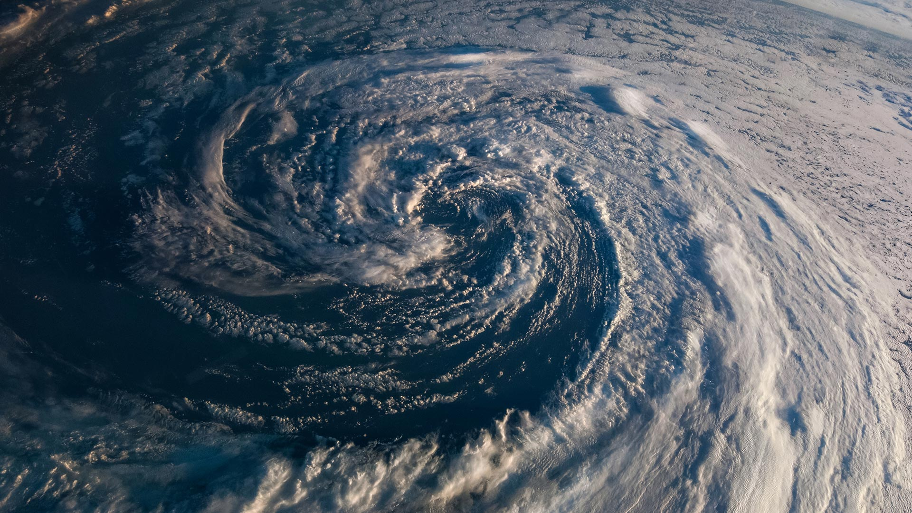
Which two of these countries are most likely to experience a tropical storm?
Question 3
A
B
C
D
Spain
Cuba
Egypt
Philippines
www.rayburntours.com

Slide 67
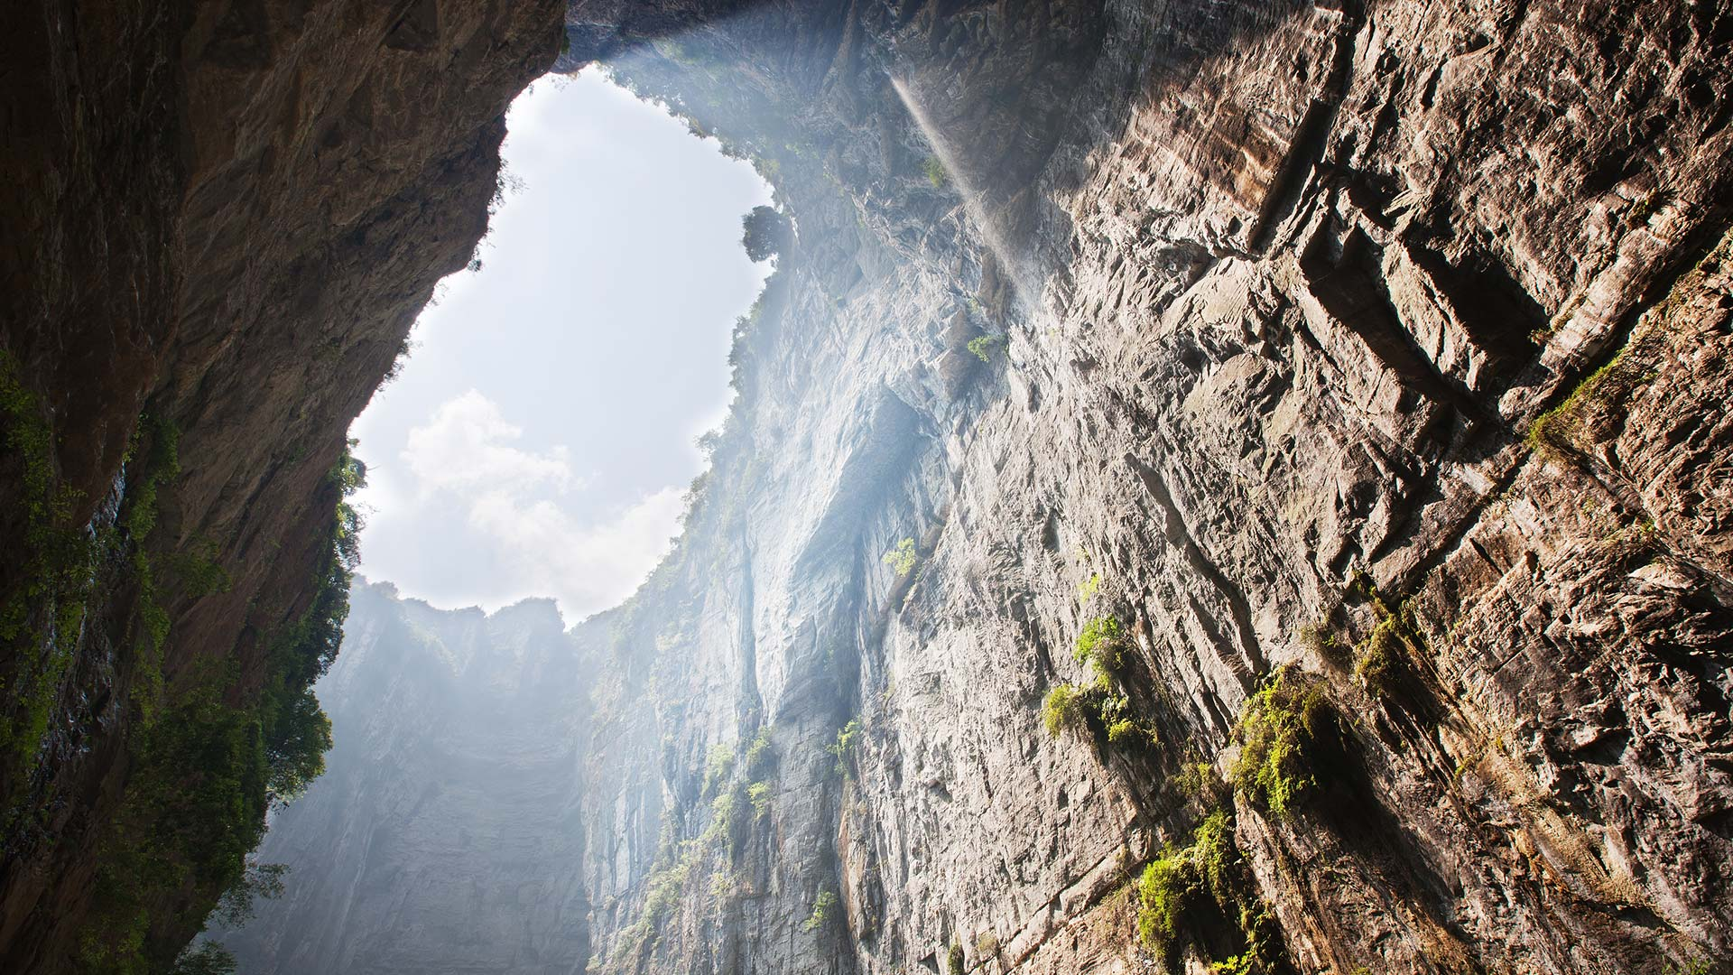
China has recently started encouraging ‘sink hole tourism’ and has discovered new species underground.
Question 4
TRUE
FALSE
www.rayburntours.com

Slide 68
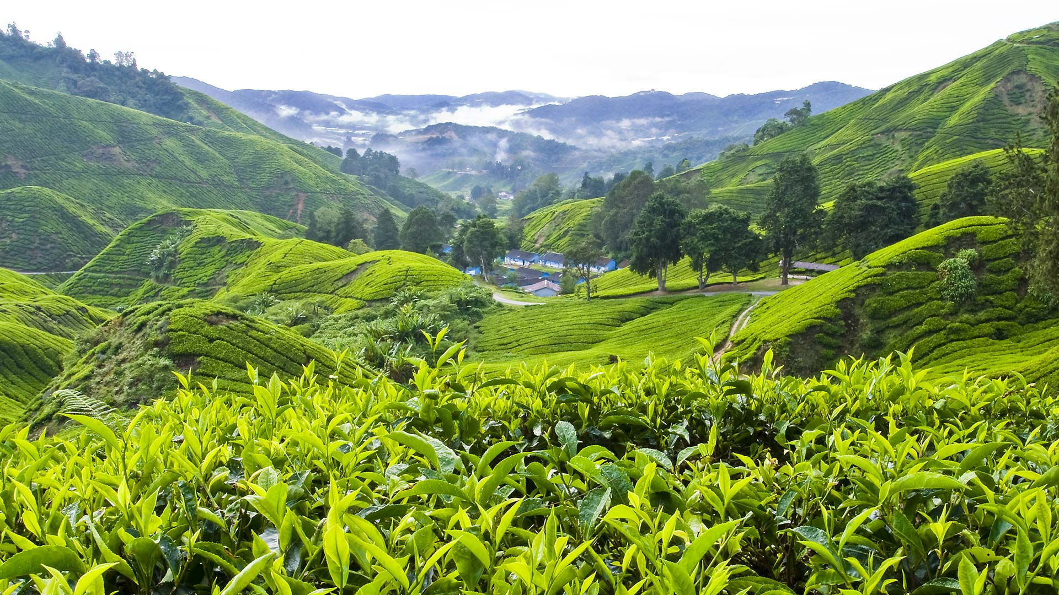
What natural hazard has caused extensive damage in Malaysia in 2024?
Question 5
A
B
C
D
Earthquake
Floods
Volcanic eruption
Tsunami
www.rayburntours.com

Slide 69
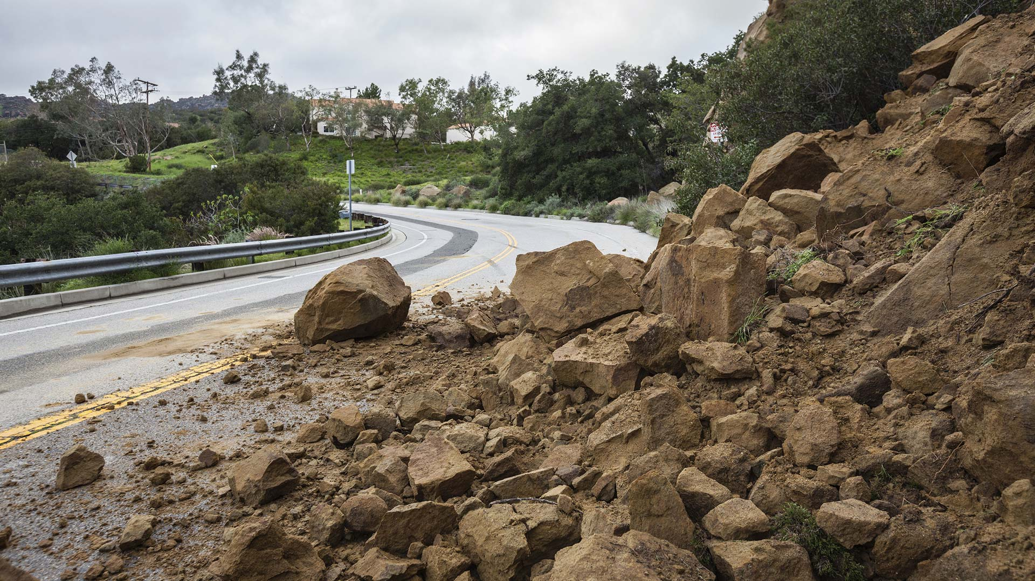
Odd one out: Which one of these does not cause landslides?
Question 6
A
B
C
D
Excessive rainfall
Drought
Earthquakes
Deforestation
www.rayburntours.com

Slide 70
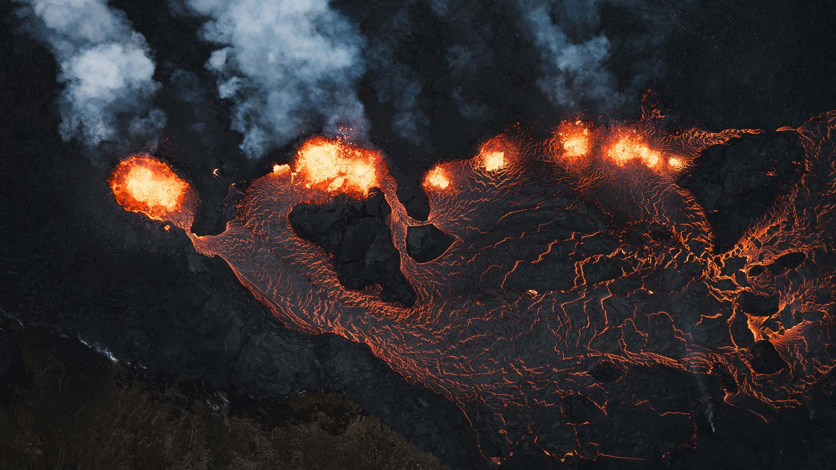
What equipment is not used for making predictions about volcanic eruptions?
Question 7
A
B
C
D
Infrared cameras
Satellite GPS
Anemometers
Tiltmeter
www.rayburntours.com

Slide 71
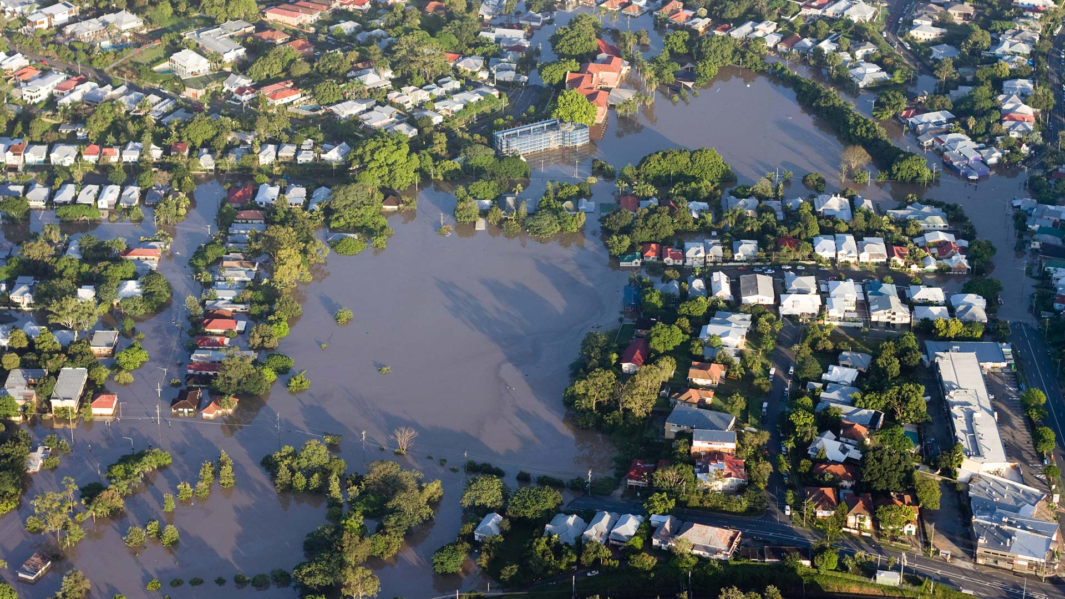
One method that can successfully reduce the risk of river flooding is:
Question 8
A
B
C
D
Reforestation
Urbanisation
Radar scanning
Seismic sensors
www.rayburntours.com

Slide 72
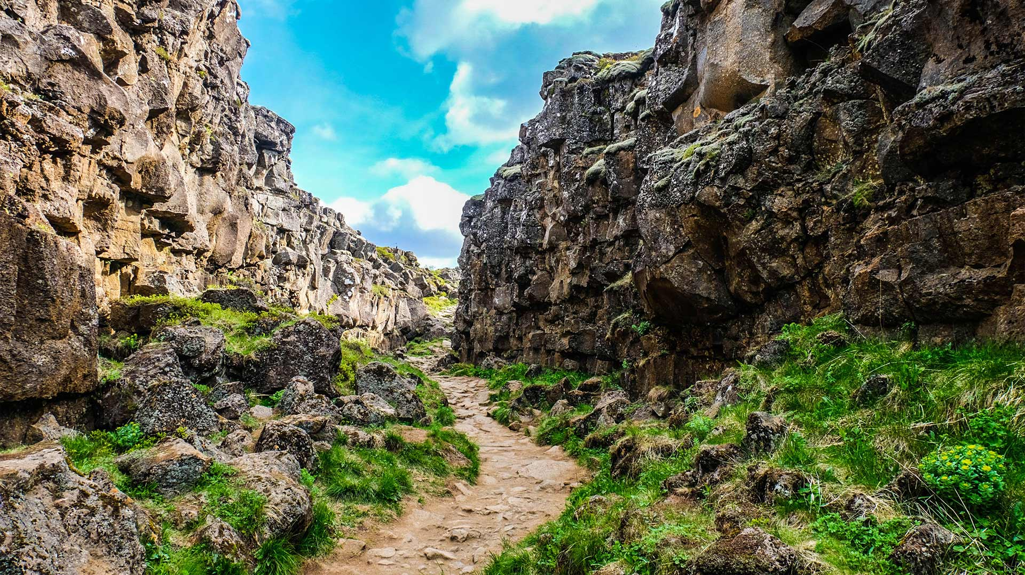
What is a slab pull?
Question 9
A
B
C
D
The upward movement of magma in a volcano
The process of tectonic plates pulling apart at mid-ocean ridges
The force made by a sinking tectonic plate pulling the rest of the plate
The pull of hot mantle on the underneath of a tectonic plate
www.rayburntours.com

Slide 73
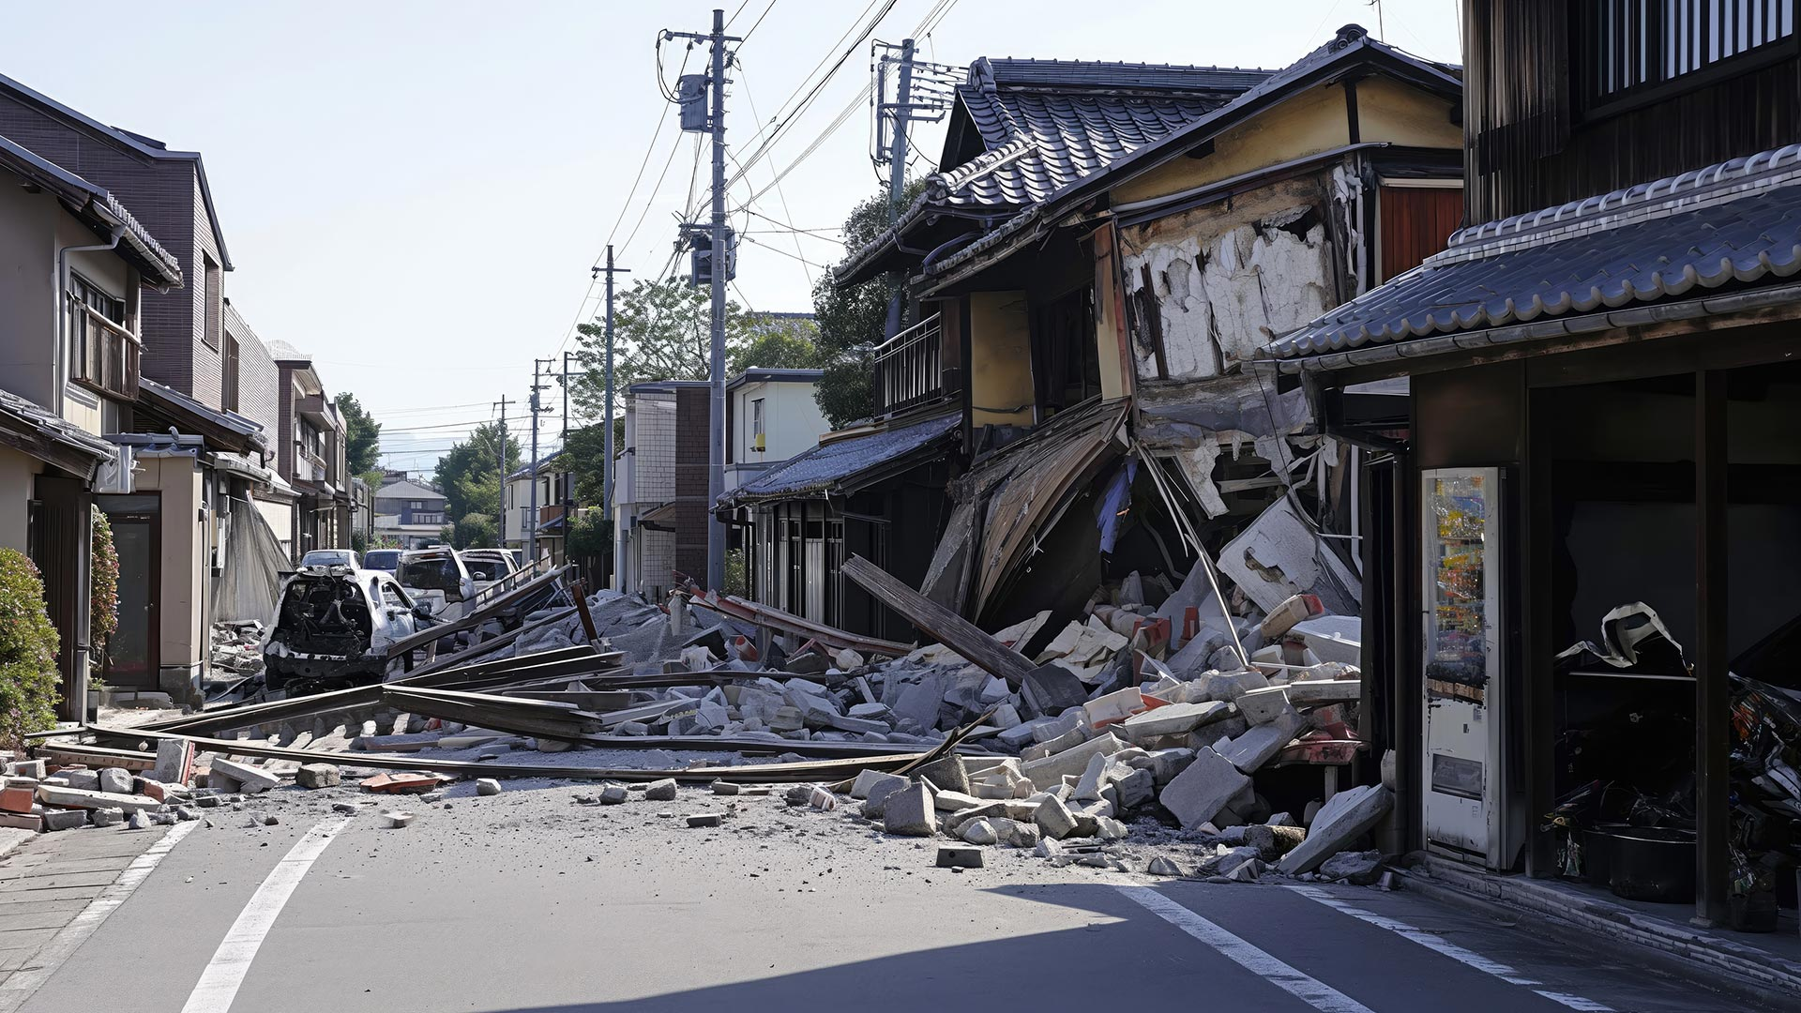
The Richter scale is the only way to measure earthquakes
Question 10
TRUE
FALSE
www.rayburntours.com

Slide 74
Round 6: Answers
True! The tenth eruption since 2021 started in November!
B) Movement of tectonic plates
B) Cuba and D) Philippines
True! China started tours deep down inside old sinkholes, and have found new species of plants at depth.
B) Floods
C) Drought
C) Anemometer
A) Reforestation
C) The force made by a sinking plate pulling the rest of the plate behind it
False. The Mercalli / Moment Magnitude Scale can also be used

Slide 75

Had great fun with our Quiz in your school?
Be sure to share your experience and tag us on social media
@rayburntours #rayburnbigquiz

